Slide 1
Venture Crew 123 Sign-Up
Notes:
Good Evening and thank you for coming tonight!
I know you all have very busy schedules so I promise to keep things brief
When you entered you should have been give a youth applications
If not, please raise your hand and one of our leaders will bring you one
If you haven’t already, please feel free to start filling out your son’s application while I give you some basic information about our Pack
If you need a pen, or have questions about the application, also just raise your hand and one of the Pack Leaders will come around to help you.

Slide 2
Venturing Video
Due to file size, the video is not included. To add the video to the slideshow, download it here:
https://scouting.webdamdb.com/bp/#/folder/627343

Slide 3
What is a Venture Crew?
Completely youth ran
Youth even create the Crew budget and plan events
Participate in high adventure actives
There are awards and recognitions but the focus is on leadership and program.

Slide 4
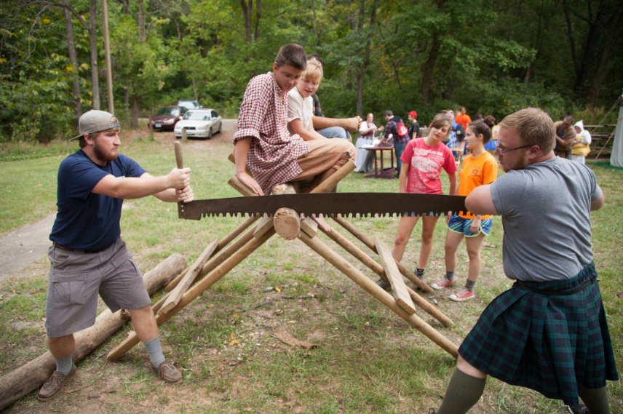
Fall Fun Rally
Notes:
Cub Scouting is all about giving our boys the opportunity to growth through unique experiences they won’t find anywhere else.
Last year our Pack had a very full program. Pictures from which you can see here.
A Fishing Derby, water bottle rockets, and an archery tournament where just a few of the many activities our Scouts participated in last year.
And we have an even more exciting year planned for you.

Slide 5
BSA Membership
Membership (August): $10.00
Membership (Sept.): $ 8.00
Notes:
So you can see that if you would like Boy’s Life the fee is $15.00 with or $10 without.
Please make checks out to Pack 123.
We will collect these with your completed application.
If you forgot your checkbook, please still turn in the completed application and we can cover the fee at the next meeting.

Slide 6
Upcoming Crew Events
List upcoming events here

Slide 7
Contact Information
Crew President:
Include contact info
Crew Vice President:
Include contact info

Slide 8
Welcome to Venturing!

