Slide 1
2020 – 2021 Unit Renewal Training

Slide 2
Unit Renewal Email
Charter renewal steps
Link to submit your Manpower Roster
Link to submit your FOS presentation
Link to download Journey to Excellence form

Slide 3
Schedule
October:
Renewal Training
Units log in to Online System and complete Renewal
November:
All Renewals are due by or before your District’s November Roundtable
For districts holding virtual roundtables – submit to DE or service center
Council processes renewal paperwork
Units clean up paperwork error issues (fees, signatures, youth or adult applications, YPT expired, background check forms)
December:
Council continues to process paperwork
Units clean up paperwork error issues (fees, signatures, youth or adult applications, YPT expired, background check forms)

Slide 4
Steps for a Successful Renewal
Before you Begin:
Submit all youth and adult applications to your local service center before you begin. This may save you from doing data entry
Determine which youth and adults are no longer participating in your Unit for 2021
Reach out to inactive youth and encourage their participation in Scouting for 2021
Notify parents and leaders about fees for 2021 and begin collection
Decide how you will obtain signatures (online or in person)
Decide how you would like to pay for renewal (Online or in person)

Slide 5
2021 Fee Structure
Youth Fees - $66.00
$25 joining fee for any new youth added plus remaining fee for 2020 ($5.50 per remaining month)
Adult Fees - $42.00
Unit Fee - $75.00

Slide 6
Steps for a Successful Renewal
How to Complete Unit Renewal:
Go online to www.stlbsa.org/2021unitrenewal
Select Register
On the next screen, enter the access code
Select your type of unit and enter your four-digit unit number. If your unit number is less than four digits, enter zeros before your number. Example: Troop 1 = Troop 0001
Create a password as instructed and click Register
Complete the information requested on each screen
Click Submit
Have Your Institutional Head or Chartered Organization Representative log into the portal and provide their e-signature to approve your renewal. You may also print the charter and have them physically sign the form.
Pay your fees either online or in person

Slide 7
Steps for a Successful Renewal
After Unit Renewal is Complete Online:
Print the final renewal and obtain signatures if you did not choose the e-signature option.
Write one unit check payable to “GSLAC” for the total amount due if you did not choose the online payment option
Collect any new youth and adult applications (with youth protection certificate and criminal background disclosure forms) that are listed on your renewal cover page.
Electronically submit your 2021 manpower roster
Electronically submit your 2021 FOS presentation information
Download and complete your Journey to Excellence form
Submit the following items by your November Roundtable
Printed charter with signatures (if you did not e-sign)
Payment
Journey to Excellence form

Slide 8
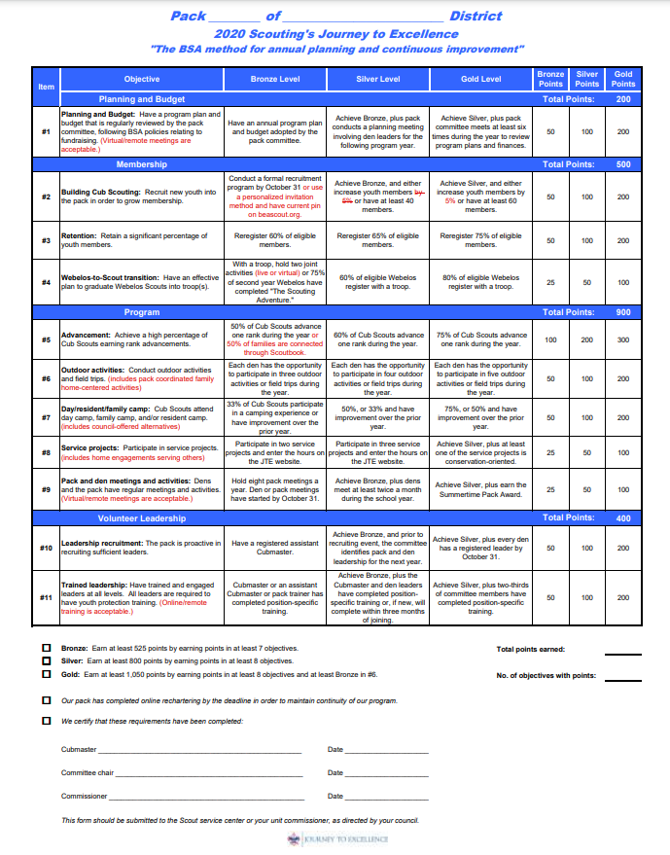
JTE Scorecard
Submit regardless of your points/level
Available at scouting.org/jte

Slide 9
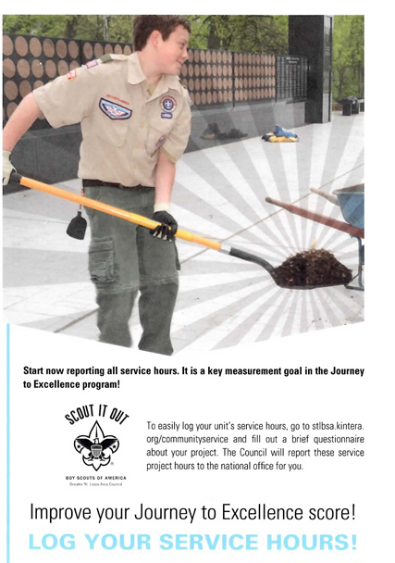
How to Log Your Service Hours
https://stlbsa.org/activities/community-service-log

Slide 10
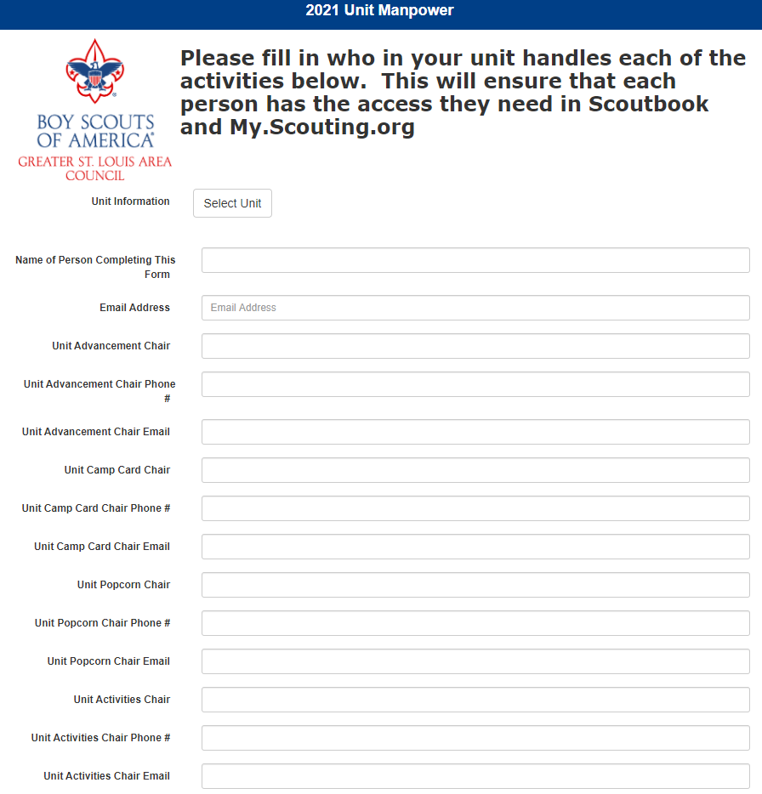

Slide 11
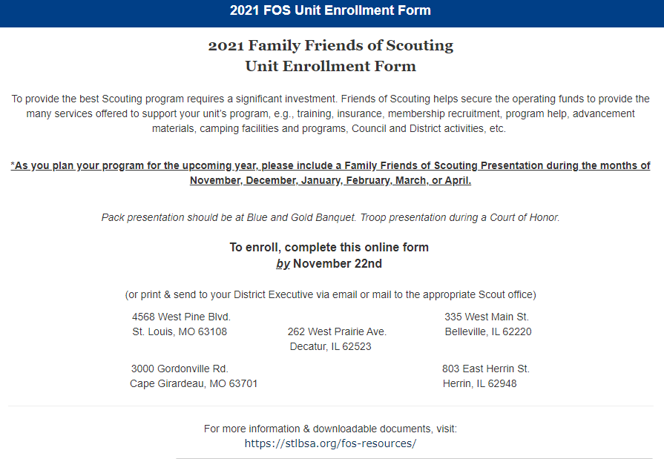

Slide 12
Renewal Due Date
Your unit renewal is due by or before your District’s November Roundtable.
If your Roundtable is held virtually, you may submit everything to your District Executive or local service center. You do not have to wait until Roundtable to submit the renewal.

Slide 13
LIVE DEMO

Slide 14
Defective Charters
Our registration staff will review the charters within two weeks of submitting
Error items will be emailed by staff to the Unit Key 3, a District Professional and District Commissioner who will forward to your commissioner
ALL errors must be cleared before the Unit can be renewed for 2021

Slide 15
Renewal in a Nutshell
Unit Renewals are due by or before the November Roundtable
Renewal can be signed electronically by the Charter Organization Representative
YPT certificate and criminal background disclosure form required for all new adult membership applications
YPT certificate required for all individuals with an expired YPT training date
A printed renewal packet can be submitted to the council service center, or if everything was done electronically, an email may be sent to your District Executive

Slide 16
Questions

