Slide 1
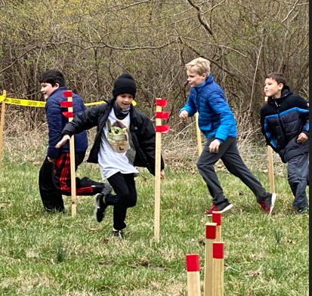
Cub Pack 999
Your own Pack photo here
Join Us
School / Church Name
Weekly Den Meetings
Monthly Pack Meetings
Year Round Outings
99 Scouts
Since
1972
Family Pack
About Us
Add Pack Elevator Speech/Slogan here Add Pack elevator speech here add Pack elevator speech here add Pack elevator speech here add Pack elevator speech here add Pack elevator speech here add Pack elevator speech here Add Pack elevator speech here add Pack elevator speech here Add Pack elevator speech here add Pack elevator speech here Add Pack elevator speech here add Pack elevator speech here
Why Cub Scouts?
Make New Friends
Boys & Girls in grades K-5
Pinewood Derby
Build & Race Your Car
Service
Community Projects
Scouting for Food
Outdoor Adventures
Camping
Hiking
www.webpage.org | cubpack@gmail.com | 314.555.5555
Cubmaster – First Last Name Asst. Cubmaster – First Last Name

Slide 2
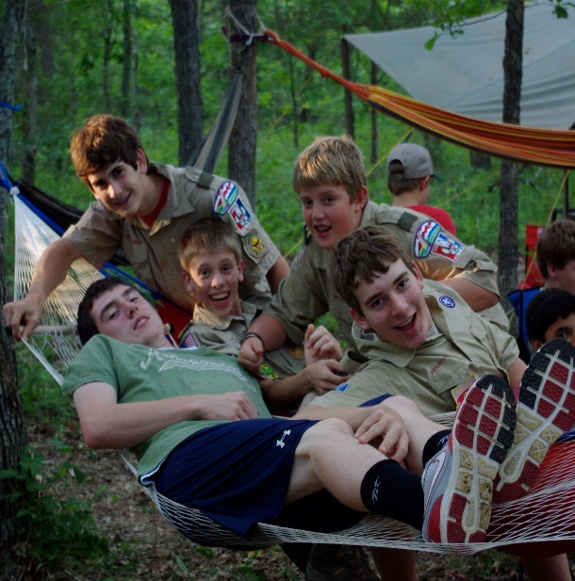
Cub Pack 999 - 2022 – 2023 Calendar
August 11 – All Leader Planning Mtg 29 – 1st Pack Meeting | February 6 – Den Meetings X – Pack Meeting
September 1 – Popcorn Sale Begins 6 – Den Meetings 7 – School Night to Join Scouting X – Pack Meeting 30 – Oct. 2 – Fall Camporee @ Warren Levis | March 4 – Pinewood Derby @ location 6 – Den Meetings X – Pack Meeting Xx – Blue & Gold Banquet @ location
October 1 – Cub Launch @ Beaumont 8-9 – Call of the Wild @ Cub World 6 – Den Meetings X – Pack Meeting 15 – Fright Fest @ Beaumont | April 6 – Den Meetings X – Pack Meeting
November 12 & 19 Scouting for Food Xx – Popcorn Pick Up 6 – Den Meetings X – Pack Meeting | May 5 – 7 Spring Camporee Beaumont 6 – Den Meetings X – Pack Meeting
December 6 – Den Meetings X – Pack Meeting | June Xx – xx Webelos Camp Xx – Leader Wrap Up Meeting
January 2023 6 – Den Meetings 7 – Pinewood Derby Workshop @ Maryland Heights COC X – Pack Meeting | July Xx – All Leader Planning Meeting
Scout/Family Testimonial Scout/Family Testimonial Scout/Family Testimonial Scout/Family Testimonial Scout/Family Testimonial Scout/Family Testimonial Scout/Family Testimonial
Scout picture here

