Slide 1
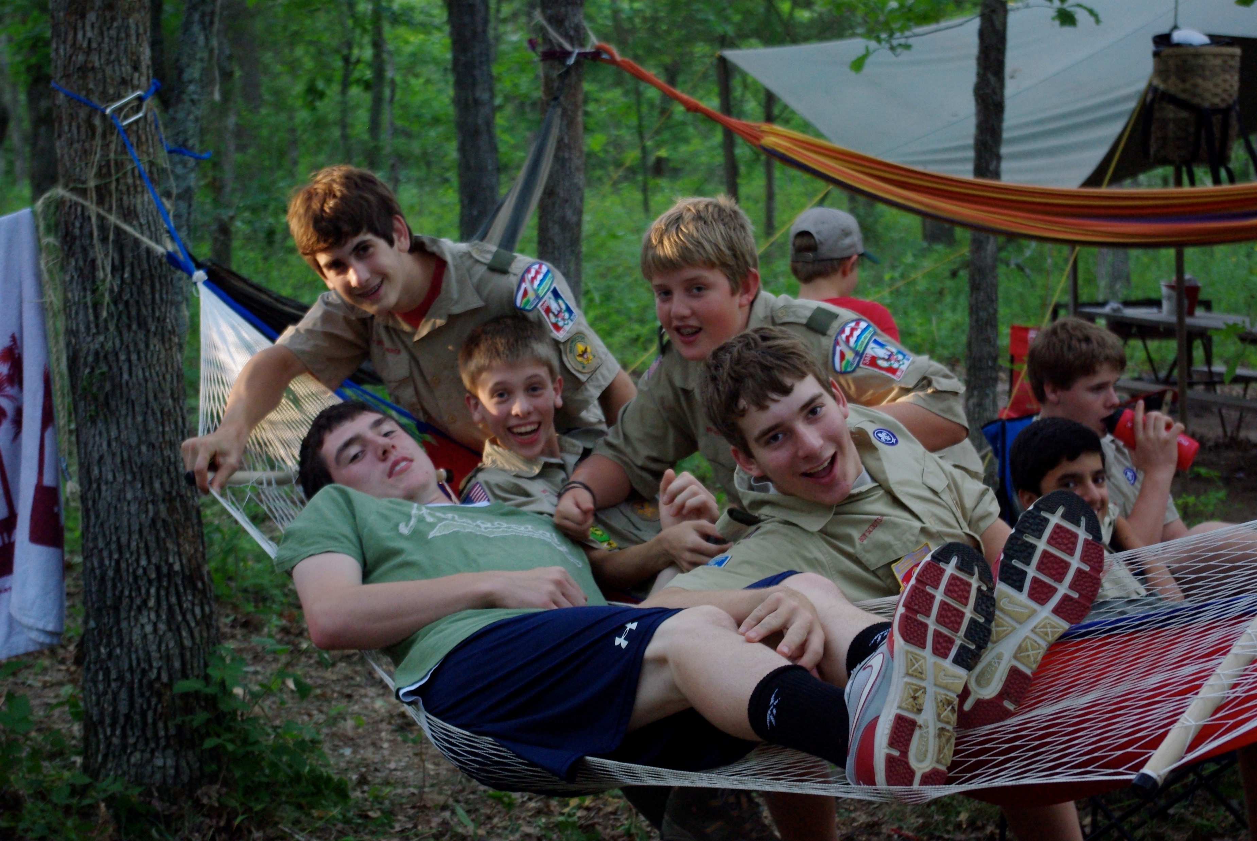
Your Troop patch/logo here – remove the burst too
Your own Troop photo here
Join Us
School / Church Name
Weekly Troop Meetings:
Mondays @ 7 p.m.
Xxx School Cafeteria / Gym / etc.
99 Scouts
Since
1972
Boy
Troop
About Us
Add Troop Elevator Speech/Slogan here Add troop elevator speech here add troop elevator speech here add troop elevator speech here add troop elevator speech here add troop elevator speech here add troop elevator speech here Add troop elevator speech here add troop elevator speech here Add troop elevator speech here add troop elevator speech here Add troop elevator speech here add troop elevator speech here
Why Scouts BSA?
Learn New Skills
Make new friends
Take on New Responsibilities
Gain Confidence
Build a moral compass
Leadership Development
Bigger (and more) Adventures
Explore different careers
Learn to Be Prepared, Make Plans & Get Stuff Done
www.webpage.org | troop@gmail.com | 314.555.5555
Scoutmaster – First Last Name Asst. Scoutmaster – First Last Name

Slide 2
Troop 999
2022 – 2023 Calendar
August 11 – Sr. Patrol Planning Mtg 29 – 1st Troop Meeting | February 25 –Klondike @ Beaumont
September 6 – Troop Meeting - Elections 16 – 18 Venturing Fall Fun Rally @ TBD X – Court of Honor 30 – Oct. 2 – Fall Camporee @ Warren Levis | March Xx – spring break adventure 24 – 26 – Taste of Venturing @ TBD
October X – activities here 24 – Pumpkin Chunkin | April Xx - 20 mile hike
November 12 & 19 Scouting for Food 28 – Turkey Bowl | May 5 – 7 Spring Camporee Beaumont Xx – Court of Honor
December X – Court of Honor | June Xx – xx Summer Camp
January 2023 Xx – Ski Trip | July Xx – xx High Adventure
Scout/Family Testimonial Scout/Family Testimonial Scout/Family Testimonial Scout/Family Testimonial Scout/Family Testimonial Scout/Family Testimonial Scout/Family Testimonial
Scout picture here

