Slide 1
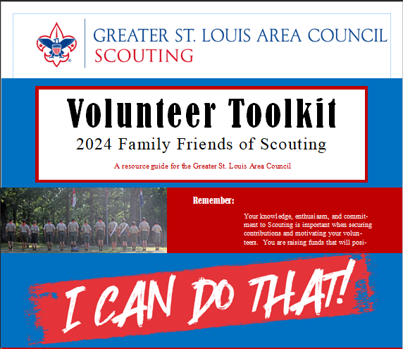
2024 Friends of Scouting

Slide 2
Opening
Kenny Wolff
Gravois Trail District Executive

Slide 3
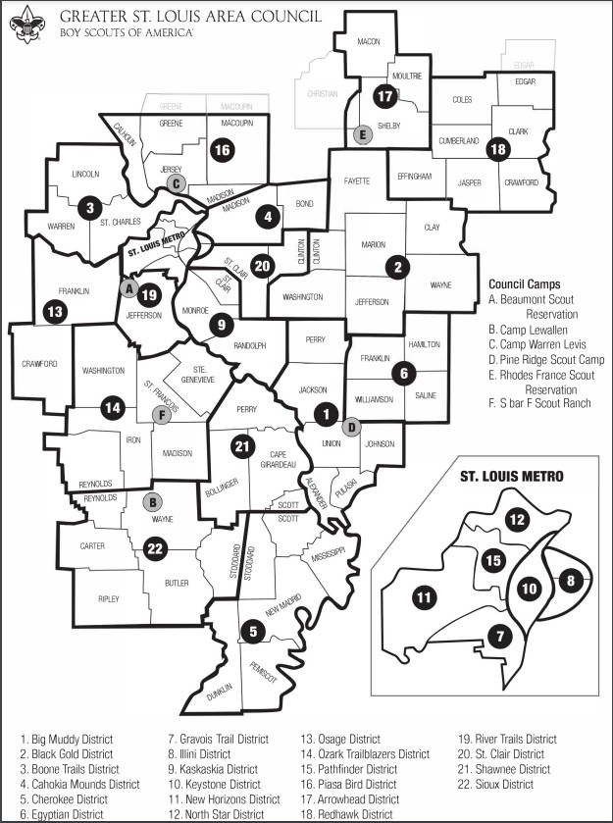
Scouting in the Greater St. Louis Area Council

Slide 4
How is Scouting Funded?
Product Sales (popcorn, camp cards, coffee) – 7%
Investment income – 19%
Camping & Activities Revenue – 22%
Special Events – 8%
United Ways – 10%
Other – 13%
Friends of Scouting – 21% Board Campaign District Campaign Community Campaign Family Campaign

Slide 5
What is Friends of Scouting?
Local Annual fundraising campaign for current Scout families & the Scouting alumni
21% of the council’s annual budget
Keeps the cost of scouting down for everyone
It’s a campaign for those who CAN or have the means to invest in Scouting

Slide 6
Where does the money go?

Slide 7
Where does the money go?
Registration fee assistance
Summer camp scholarships
Assistance for uniforms books advancement
Activity scholarships for STEM, merit badge days, career exploration, impactful day programs
Scouting programs for at-risk youth

Slide 8
Where does the money go?
Camp property improvements & maintenance
Expansion of camp program areas
Expansion of Scouting programs in STEM, career exploration, medical first response
Recruitment and promotion materials
Adult training materials
Supports community service projects

Slide 9
Where does the money go?
Customer service
Necessary behind the scenes essentials like:
Council website
Social media pages & promotion
Program calendars, activity guides, etc.
Someone to process advancement, youth & adult awards, training, and membership

Slide 10
Family FOS Plan
Objectives
Increase funds raised in the Family FOS campaign
Families / Avg. Gift – 2023 21.5% / $127
– 2022 25.0% / $108
Focus more attention on the donor experience
Create a comfortable environment at unit meetings
Use familiar giving methods (crowdfunding)

Slide 11
Friends of Scouting Goal
$1,659,500
2024

Slide 12
Family FOS Positions

Slide 13
Family FOS Positions
Family FOS Chair
Recruit & train trailblazers & crew chiefs
Promote FOS at Roundtables
Schedule Kickoffs & Celebrations by Jan 20; assign to trailblazers
Motivate team / regular communication

Slide 14
Family FOS Positions
Crew Chief
Manage a specific zone of units/trailblazers
Provide trailblazers with supplies & collect funds
Assist in training trailblazers
Assist with unit kickoff & celebration signups

Slide 15
Family FOS Positions
Trailblazer
3-6 units each
Collect dates from your units
Work with unit leaders before date
Conduct kickoff & celebration meetings
Distribute recognition items
Help unit follow up

Slide 16
Family FOS Plan
Oct/Nov
Cultivation communication
Nov/Dec - Pacesetter campaign
Top Donors
District committee/commissioner staff
Schedule unit presentations
January – Council-wide warmup letter

Slide 17
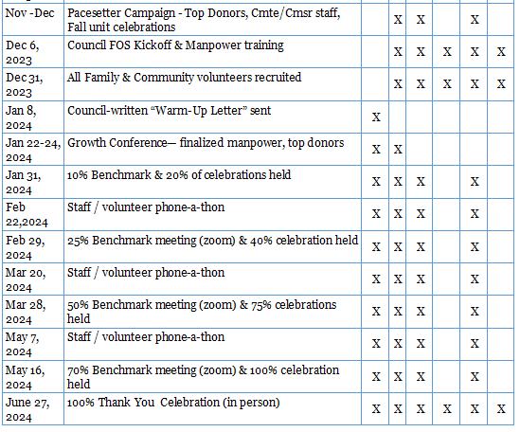
Key Campaign Benchmarks

Slide 18
Unit FOS Campaign
Campaign enhancements
Updated brochure
Crowdfunding pages streamlined
Reduced # of incentives to simplify
Updated unit incentive
Greater emphasis on matching gifts/volunteer hour matching

Slide 19
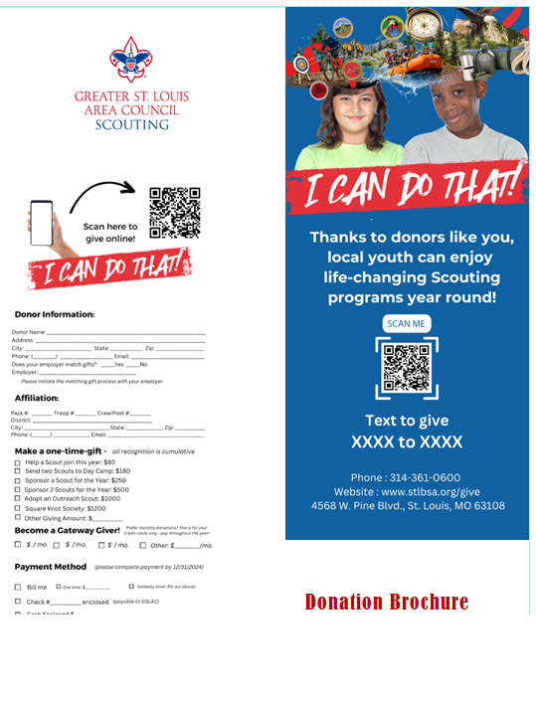
2024 Brochure

Slide 20
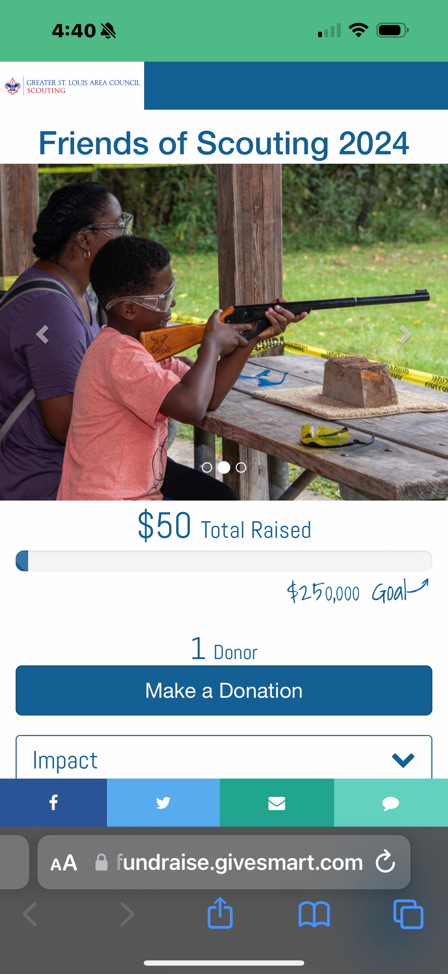
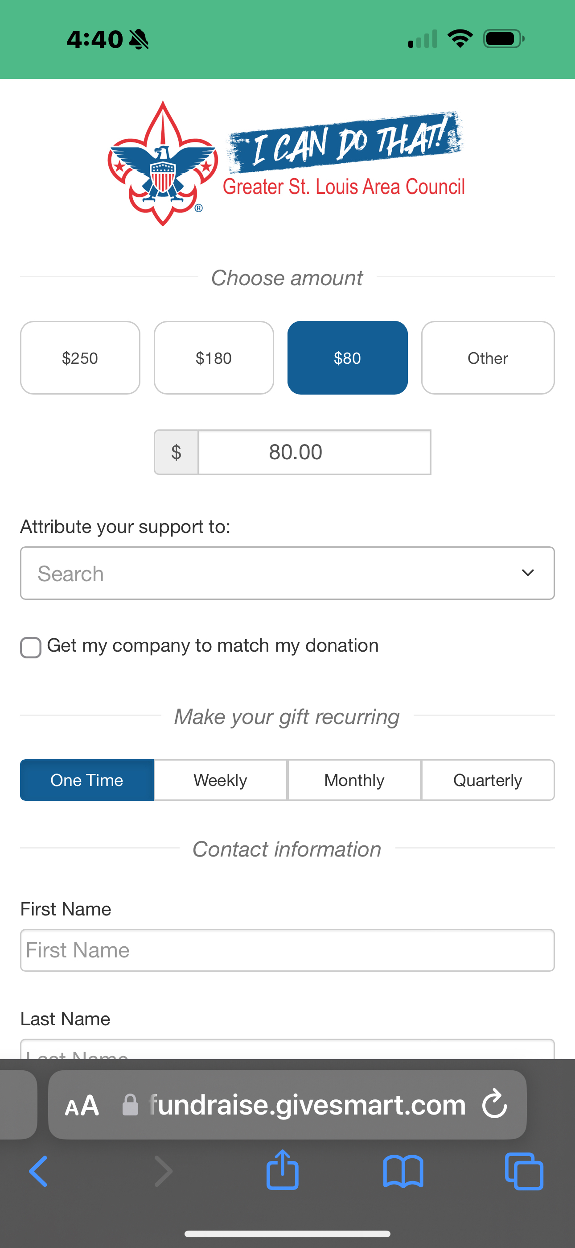
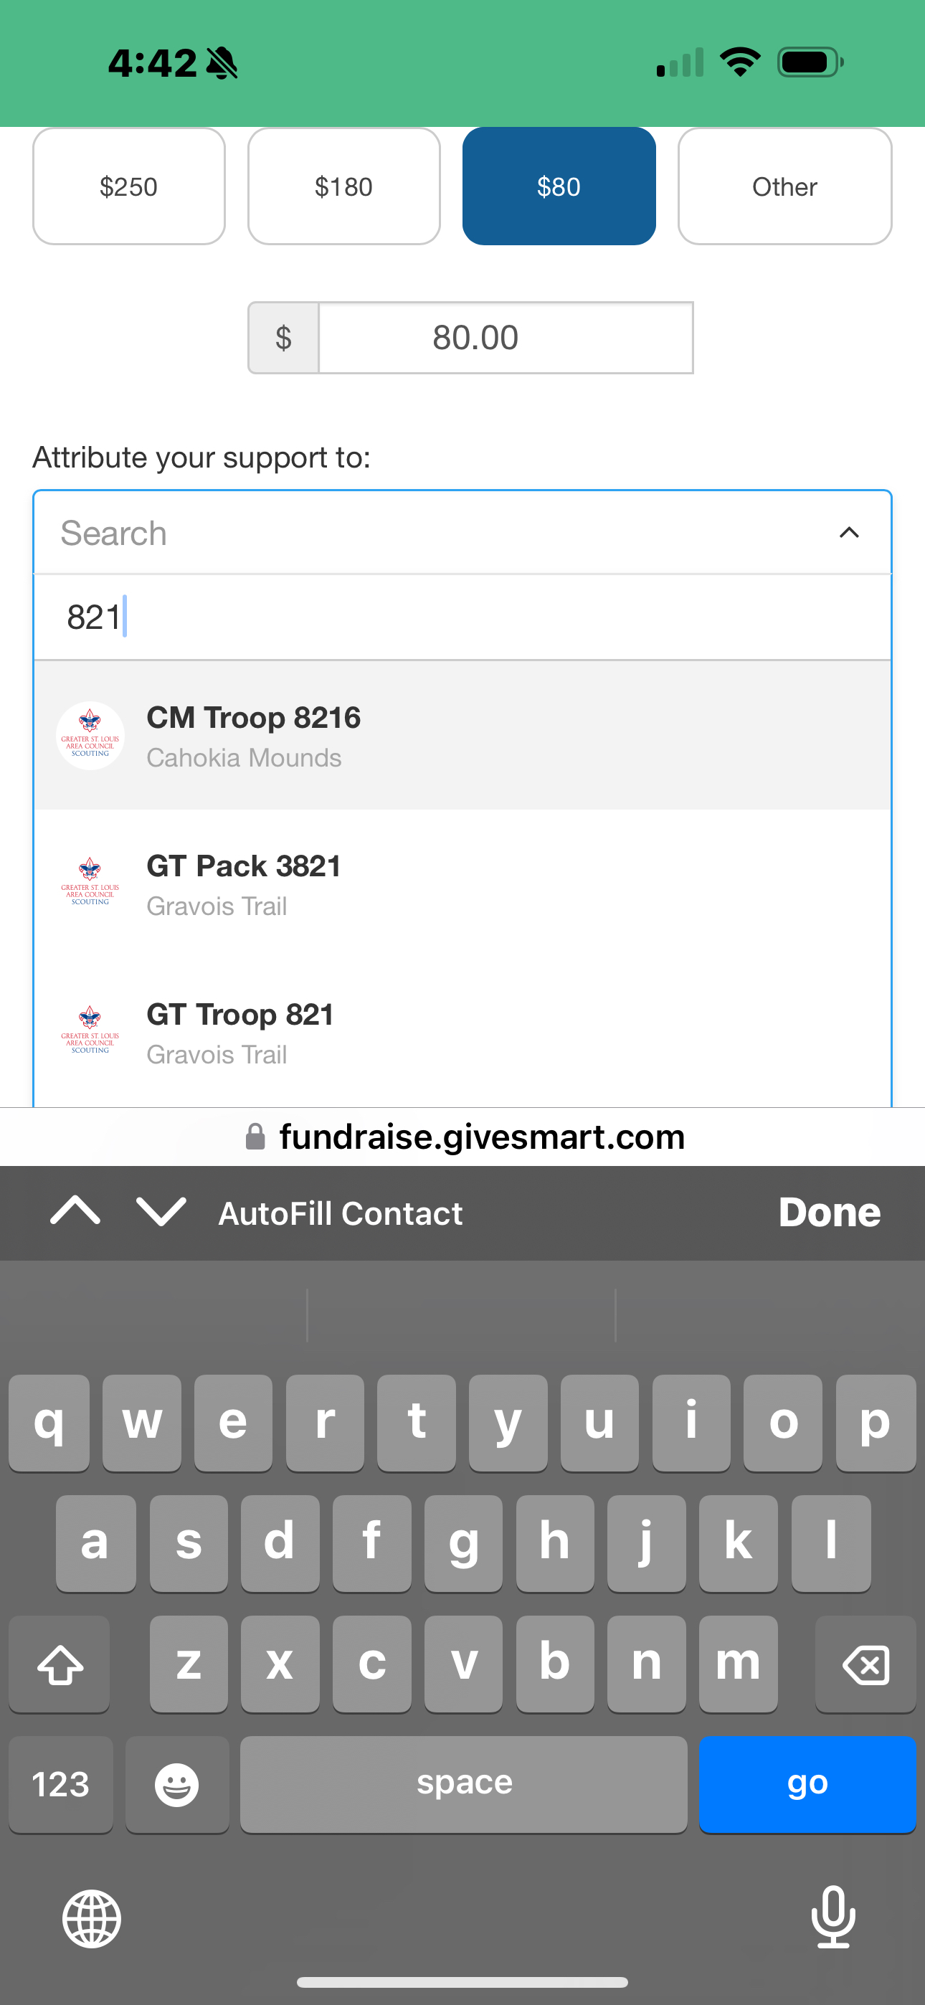
Mobile Giving

Slide 21
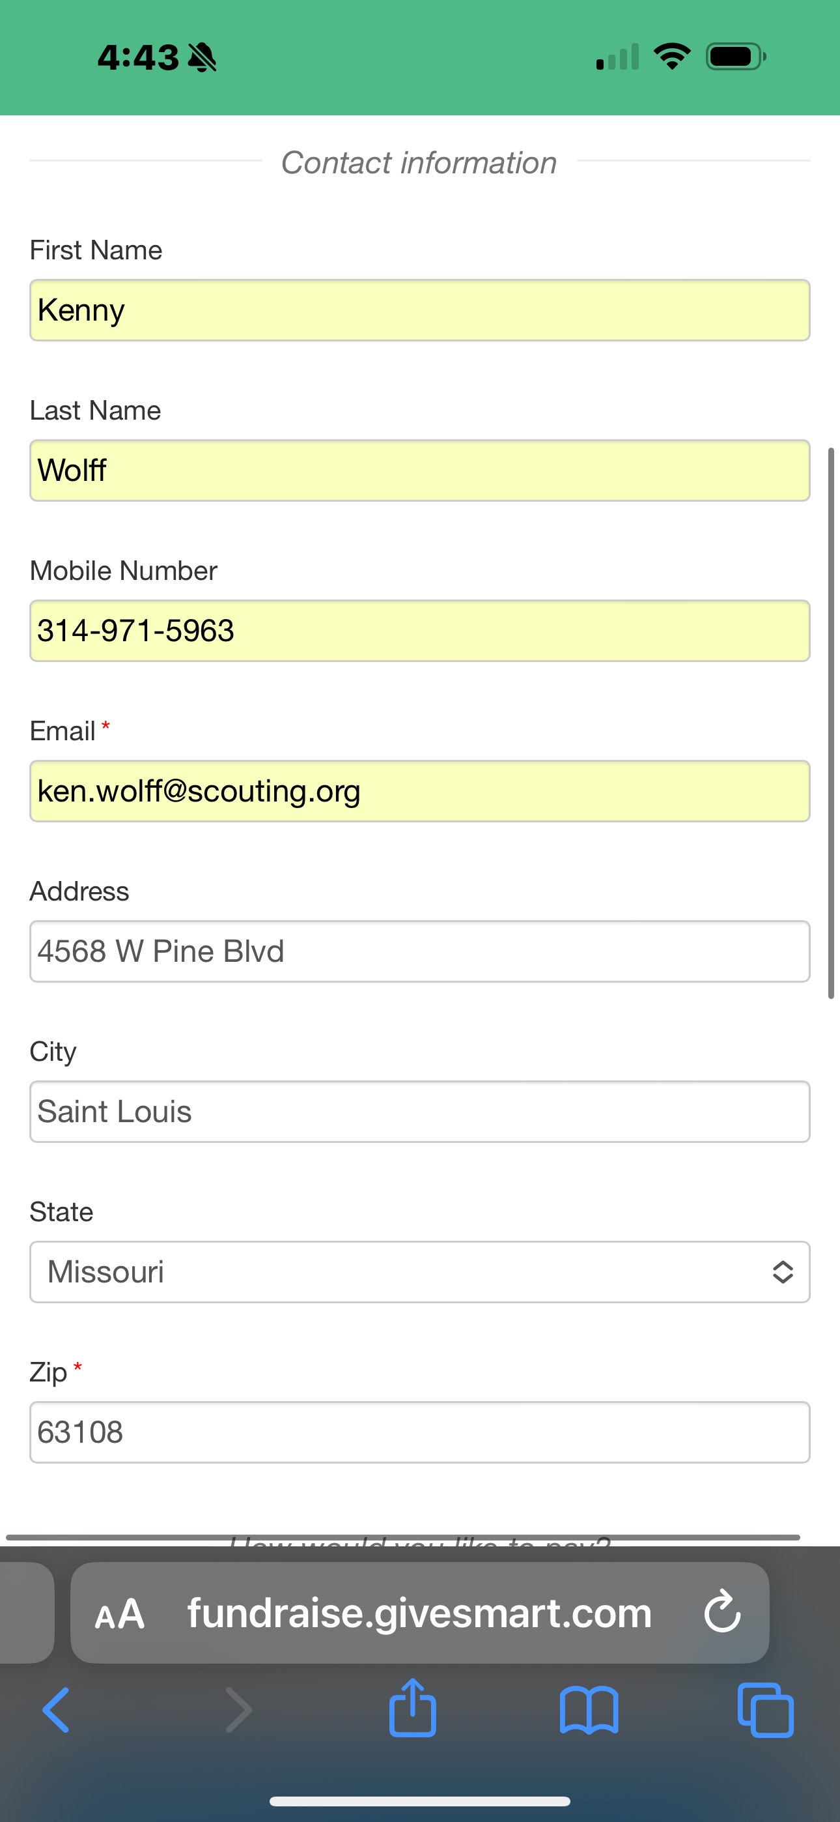
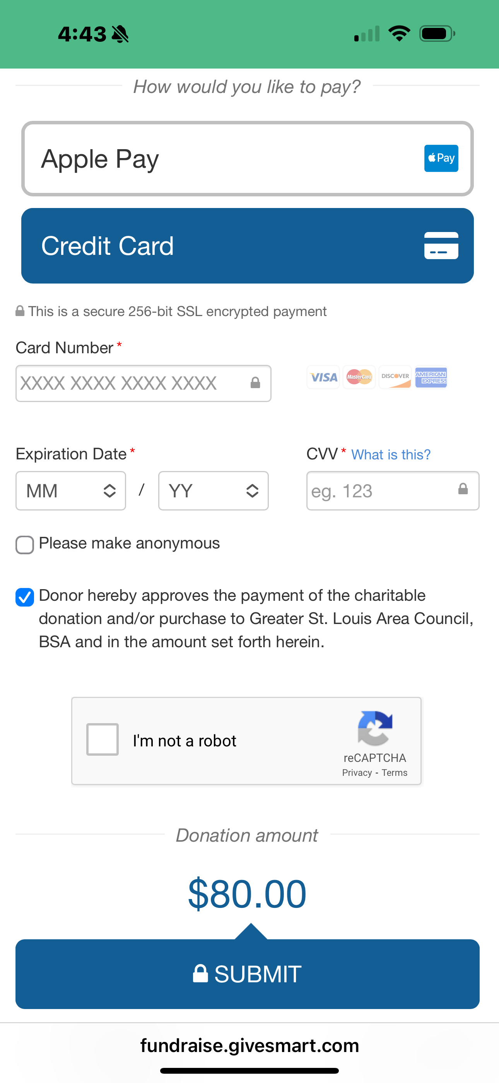
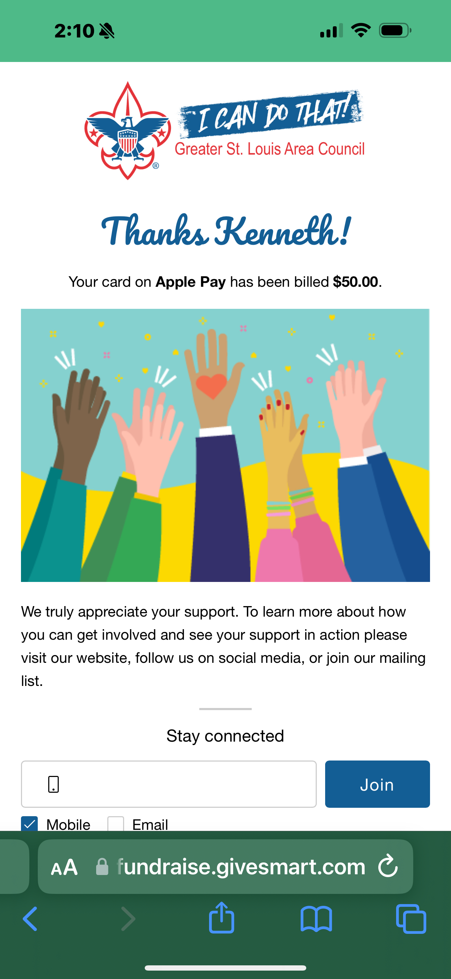
Mobile Giving

Slide 22
What units to focus on?
High potential
Units with history of giving
12/7/2021

Slide 23
Communicating with Units
KNOW THE DETAILS
Communicate early (NOW) & often
Identify a point person to champion each units campaign: Top donors in unit are great to engage for this role.
Utilize Roundtable/District Meetings to get the word out and encourage early giving.

Slide 24
Unit Kickoff
Email is sent to unit members at least 3 weeks ahead of the celebration date.
Push the crowdfunding page to their network and social media network
This will give time to make a family decision, discuss, ask more questions, Inspire others
Secure historic givers first. They understand the mission.
Focus on larger donors with a personal one on one ask.

Slide 25
Top Donors: Making the ask.
Do your research
Meet with the right person - People give to people.
Say thank you PERSONALLY
Have a follow-up plan afterwards.

Slide 26
Conducting the Celebration
How do you like to be Thanked?

Slide 27
Conducting the Celebration
Share positive council updates, property improvements, successful programs etc.
Thank you for the effort in the campaign, to donors, unit leaders
Share the results of the unit’s campaign
Direct ask to give if families haven’t donated

Slide 28
Talking to your units about the importance of giving

Slide 29
Talk points to families
Donating demonstrates what we teach in the Scout Oath and Scout Law
Scouting is an investment in youth/ communities.
Scouting has changed lives because of FOS. Use examples relevant to the area.
We teach our kids to take action & do what's right for the people around us. Take action by investing in Scouting

Slide 30
Follow-up Strong!!!!
Within 1 week of Celebration!
Check in with trailblazer & Unit Leader to help move needle as often as needed!
Call Nights!
Council follow up letter

Slide 31
Q&A

Slide 32
Executive Comments
Martez Moore
Deputy Scout Executive

Slide 33
THANK YOU!

