Slide 1

Boone Trails District
Roundtable – Scouts BSA
06 February 2024

Slide 2
Recognitions
New Attendees!

Slide 3
Fun Trip or Activity!
Who had a neat trip\activity\experience they want to share with the group?

Slide 4

Spring Camporee
John Grogan, Campmaster
April 26 – 28, 2024
at
Camp Warren Levis
Theme: “Revisiting the 1940’s”

Slide 5





2024 Fall Camporee
Opportunity for Scouts to Gain Leadership Experience on Camporee Staff
October 11 – 13, 2024
Camp Warren Levis
2025 Klondike
TBA
Beaumont
2025 Council Event
Replaces Spring Camporee
April 25 – 27, 2025
All Council Camps

Slide 6


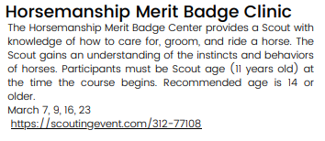
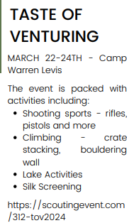
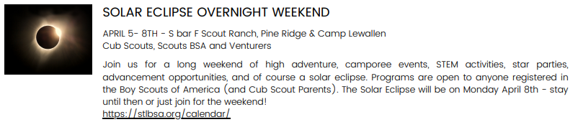

Slide 7

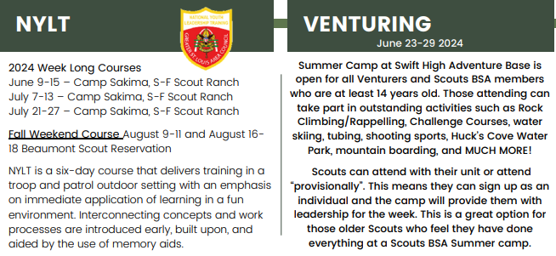
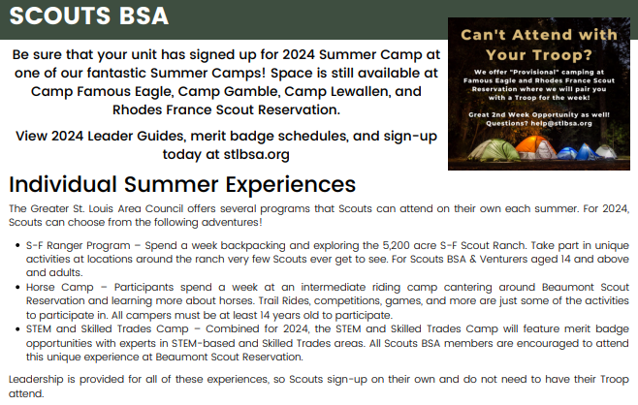


Slide 8

NYLT Summer Dates 2024
2024 Summer Weeklong Courses:
June 9-15 – Camp Sakima, S-F Scout Ranch
July 7-13 – Camp Sakima, S-F Scout Ranch
July 21-27 – Camp Sakima, S-F Scout Ranch
2024 Weekend Course –
August 9-11 and August 16-18
(Both weekends must be attended to successfully complete the course)

Slide 9
Training
  TJ Foley <tjfoley9540@gmail.com>
  NYLT Scholarships
  Wood Badge
    Information Dinner
      26 February
      7 PM
      Beaumont

Slide 10
Advancement
Boy Scout Advancement Chair
  Gary Obernuefemann <BTAdvancementGSLAC@gmail.com>
District Advancement Chair
  Jay Byington <bblackbear8@gmail.com>

Slide 11
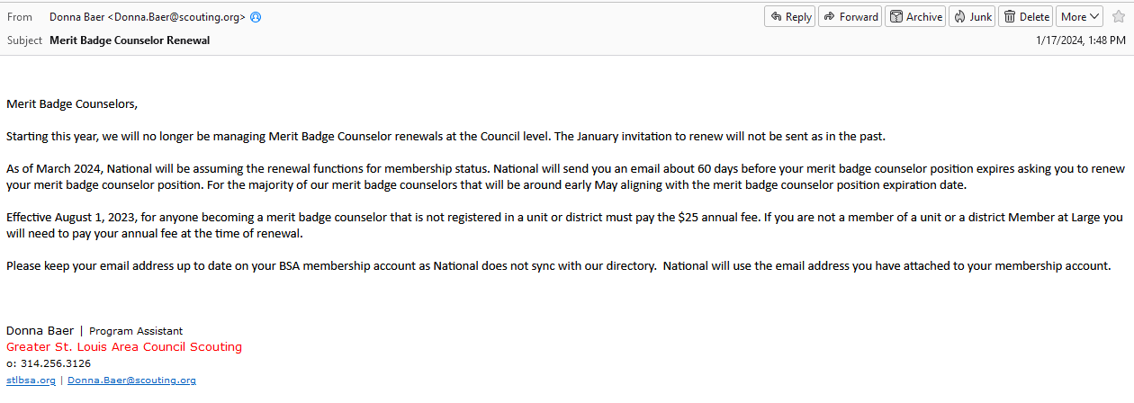
Merit Badge Counselor Renewal Change

Slide 12

Local MB Opportunities
Boone Trails Fishing Clinic
Saturday, August 10th, 2024
8:00am - 12:00pm
Busch Wildlife Lakes 1*, 2, and 15
* This year we are adding the Fishing and Fly-Fishing merit badges at Lake 1 for Scouts BSA as part of the District Merit Badge Skill Center. In addition, the Scouts BSA will also be able to earn requirement 2 of the Complete Angler Award. This portion of the program will extend into the afternoon per the merit badge counselors needs.

Slide 13
2024 GSLAC BSA Paddle Craft Safety Training Courses and
Swimming & Water Rescue Course Information
Mike Meenehan
GSLAC Aquatics Training
ASM T873
mmmeenehan@gmail.com

Slide 14
2024 GSLAC BSA Paddle Craft Safety Training Courses
Course Prerequisites
-Be at least 15 years old; Submit health review (Part B only, will be reviewed at the course);
-Complete the BSA swimmer test;
-Have current Safety Afloat training (available online at myscouting.scouting.org/)
2024 Paddle Craft Safety Basic Course Schedule
Date Registration Deadline Location
11 May 6 May Camp Lewallen Silva MO
2024 Paddle Craft Safety River Course Schedule
Date Registration Deadline Location
12 May 6 May Camp Lewallen Silva MO

Slide 15
2024 GSLAC BSA Swimming & Water Rescue Course Information
Course Prerequisites
-Be age 15 years or older prior to training
-Submit health review (Part B only, will be collected at the course)
-Have current BSA swimmer classification and Safe Swim Defense training (is available online at https://myscouting.scouting.org/)
Swimming and Water Rescue 2024 Course Schedule
Date/Time Registration Deadline Location
6 April 1 April Chuck Fruit Aquatic Center 6168 Center Grove Rd,
9am – 3pm Edwardsville, IL 62025

Slide 16
Religious Programs
  Larry M. for the protestant denominations/non-denominational churches
  Phillip LaBanca phillip.labanca@gmail.com (Roman Catholic)

Slide 17
Religious Programs
Ad Altare Dei
Troop 35 Troop 72 Troop 351
Oliver Rothweiler Jeffery Anthony Luke Archer
Andrew Dugan John Frauenhoffer Hunter Smith
Logan Tihen
Troop 506 Troop 853 Troop 856
John Baldetti Landon Tasios Billy Simon
Troop 911 Troop 918
Nichole Kipper Julian Hanquet
Justin Wingbermuehle
Pope Saint Paul VI National Catholic Unit Excellence Award
Pack 918 St. Joseph Parish, Cottleville

Slide 18
Additional Important People!
  Venturing Officers' Association Advisor
  Nick and Liz Tuley <ntuley911@gmail.com>
Newsletter
  bsaboonetrailspr@gmail.com
Kalki Devos – VSOA President

Slide 19
Scouting Events
Walter Schnurr scout.master.troop.35@gmail.com

Slide 20
Cub Scout Day Camps
Cub Scout Camp Registration
https://scoutingevent.com/312-77333
Twilight STEM Camp, Cottleville, June 3 through 7 - Mr Schnurr
McNair Day Camp, June 24 through 28 - Ms McMilian
Cuivre River State Park (Lincoln County), July 15 through 18 - Ms Dustin

Slide 21
Boone Trails Fishing Clinic at Busch Wildlife
Mr Schnurr
* August date will be announced soon

Slide 22
Den Chief Training
https://scoutingevent.com/312-denchieftrainingspring
Den Chief's needed for District Day Camps (and Fishing Clinic).
Spring Den Chief - Virtual Class
Saturday 03-16-2024
9:00 AM CT to 12:00 PM CT
Spring Den Chief - In-Person Training
Camp Warren Levis
Saturday 04-27-2024
9:00 AM CT to 12:00 PM CT

Slide 23
Den Chief Training
Registration to apply is open for Den Chief registration
https://forms.gle/heuYkjrRsRrzbhh27
District Den Chief GroupMe
This is for Den Chief Announcements for staffing opportunities for District, Pack, and Den. Den Chiefs should request to join.
https://shorturl.at/fpquz

Slide 24
Powder Horn – Walter Schnurr
Weekend 1: Swift High Adventure Base (Optional)
|Friday, April 12th, 6:00 PM through Sunday, April 14th, 2:00 PM
Weekend 2: Beaumont Scout Reservation (Required to earn award)
Friday, May 3rd, 6:00 PM through Sunday, May 5th, 2:00 PM

Slide 25
Big Rock Topic
Parent Engagement
One way is to let the parents in on some of the fun stuff. What is the fun stuff in Scouting? Camping.
Schedule events that the parents can enjoy with their scouts. An annual dinner event that is built on the quarterly Court Of Honor.
Look for a responsibility or position within the Troop might be a good fit for their job skills, talents, personality, or their interests.

Slide 26
Parent Engagement (continued)
Try not to force the parents into a particular mold.
If a parent travels a lot and can’t attend a lot of events, just encourage them to participate when they are in town.
Encourage the parents to tag team, take turns to accompany their scout to an event; even if it is just for part of the event.
Employ the parents of longtime scouts to engage the new parents to make them feel welcome in the troop.

Slide 27
Parent Engagement (continued)
Keep the parents in the communication loop. Communicate in a timely manner. Give updates when needed. Post weekly/bi-weekly news about the Troop.
When the parents are involved in the Troop, the scouts tend to do much better than the scouts whose parents just drop them off and go.
It is nice for the parents to enjoy some extra time with their scout as well as for the scout to spend dedicated time with their parent(s).

Slide 28
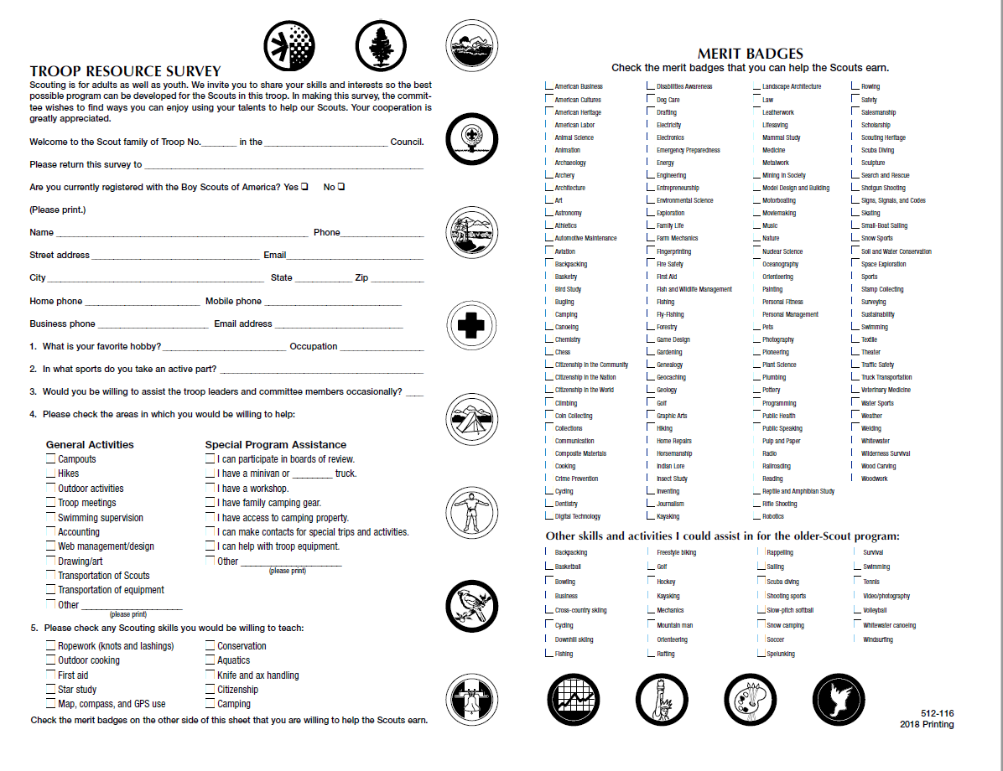
Parent Survey
https://filestore.scouting.org/filestore/pdf/512-116_WB.pdf

Slide 29
Questions???

Slide 30

News from the Floor
Do you have an announcement you would like to share with the group?

Slide 31
Upcoming Topics
Looking for volunteers!
Do you have something you are passionate about?
Is it something other troops would be interested in?
Are you willing to present it to others?
Come see Paul Stamer after the meeting!
pjstamer@aol.com

Slide 32
Meeting Reminders
Come early and eat to help support the Knights of Columbus!
Sign in
We appreciate help cleaning up before we leave.
Next RT –
March 5th 2024

