Slide 1
Boone Trails Roundtable
February 2024
Special Guests:
Troop 533

Slide 2
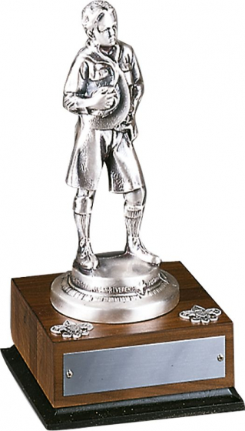
District Award Recipients 2024 Patrick Lepski Activates Chairman
Boone Award Recipients
Key Scouters
Please hold applause until the end

Slide 3
Springtime Fundraiser: Camp Cards Help ensure every Scout earns his/her way to camp this summer!! Marion Hamilton, Troop 30
Camp Card Fundraiser
March-May
Cards should be available at 3/5 Roundtable
$5 card
50% commission
No risk sale
Payment + cards due 5/26
Sign up: stlbsa.org/camp-cards/

Slide 4
Friends of Scouting Tonya Brown
Reminder: we need presentation dates
Good to know: Every unit’s giving page is live
Last year’s Friends of Scouting helped to fund at our camps:
At Beaumont, Trading Post renovations, campsite latrine improvements, Emerson kitchen upgrades, new mower, Laemmli Field Pavilion
At S-F, 3 new speedboats, shuttle bus improvements, ranger home repairs
At Warren Levis, high speed internet upgrades, new mower

Slide 5
Friends of Scouting Tonya Brown
Last year’s Friends of Scouting helped to fund at our camps:
At Lewallen, kitchen upgrades, septic system improvements, shower privatization, dining hall roof replacement, campsite tent platforms
At Pine Ridge, new roof on Bailey Lodge
At Rhodes France, pool improvements, camp office HVAC, ranger home repairs
Made possible by the success of friends of Scouting!

Slide 6
STEM ACTIVITIES Outgoing - Sophia Bright, District STEM Chair
Incoming - Niki Boone, District STEM Chair
February 2024
Other STEM Resources
Supernova Mentor and Nova Counselor Training
Training can be done virtually or in person and takes no more than 1 hour for BOTH the Supernova Mentor and Nova Counselor programs
This training does not expire
Youth Protection Training and Merit Badge Counselor training must also be completed
Contact sophia.bright@gmail.com if you are interested
Incoming STEM contact information:
nikolinaboone@gmail.com
314-616-3074
Upcoming STEM Activities
SIUC - February 24th
Lake Land College - March 16th
SUMMER CAMPS Scouts BSA/Venturing:
STEM Camp: July 14th - July 20th @ Beaumont Scout Ranch
STEM on CAMPus:
EIU & SEMO: June 2-5
UMSL: June 5-8
SUMMER CAMPS Cub Scout (Twilight):
Boone Trails STEM week June 2
CAMP NOVA! July 15-18@Beaumont Scout Ranch
Thanks for your continued support!

Slide 7
Spring Camporee John Grogan, Campmaster
April 26 – 28, 2024
at
Camp Warren Levis
Theme: “Revisiting the 1940’s”

Slide 8
2024 Fall Camporee
Opportunity for Scouts to Gain Leadership Experience on Camporee Staff
October 11 – 13, 2024
Camp Warren Levis
2025 Klondike
TBA
Beaumont
2025 Council Event
Replaces Spring Camporee
April 25 – 27, 2025
All Council Camps

Slide 11
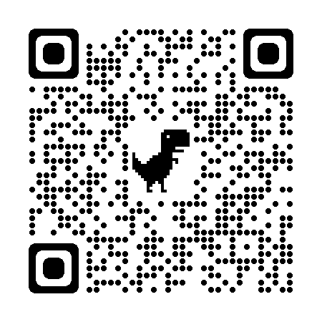
District Pine Wood Derby Patrick Lepski, Activities Chair
The District Pinewood Derby in schedule for Saturday, March 9 at the Wentzville Christian Church, 1507 Highway Z, Wentzville, MO 63385 from 9:00 a.m. until noon. Races begin at 10:00 a.m. Get there early!
Sponsored by Pack 993 and Tim Frazee.

Slide 12
Training T.J. Foley ©314-974-0852 tjfoley9540@mail.com
Training – YPT 61.67%
Direct Contact Leaders – 55.98%
Up Coming Training Events
BALOO – April 20-21/S-F Scout Ranch(Famous Eagle)
May 4-5/Camp Warren Levis
Intro to Outdoor Leaders Skills – May 3-5/Beaumont
Wood Badge – May 17-19 & June 1-2/Beaumont

Slide 13
Powder Horn – Walter Schnurr
Weekend 1: Swift High Adventure Base (Optional) |Friday, April 12th, 6:00 PM through Sunday, April 14th, 2:00 PM
Weekend 2: Beaumont Scout Reservation (Required to earn award) Friday, May 3rd, 6:00 PM through Sunday, May 5th, 2:00 PM

