Slide 1
Boone Trails Roundtable
March 2024
Special Guests:
Pack 530

Slide 2
Friends of Scouting Tonya Brown, Chair
Did you know: our Friends of Scouting gifts last year supported:
$115,000 in camperships,
$37,520 in new scout registrations this past fall, and
$200,000+ to fully fund urban and rural scouting programs
All that support and impact starts with inviting families to make a gift and invest in young people.
Still need presentation dates for Packs 3391, 3918, 3931, 3957; and Troops 389, 813, 856, 957, 990

Slide 3
Friends of Scouting Tonya Brown, Chair
Thank you to everyone participating, and special thanks to the units below for achieving their fundraising goals already!
Troop 857
Troop 911G
Troop 975G

Slide 4
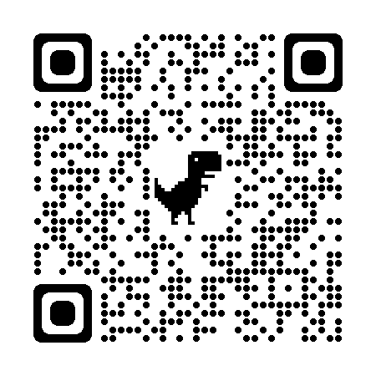
District Pine Wood Derby Patrick Lepski, Activities Chair
The District Pinewood Derby in schedule for Saturday, March 9 at the Wentzville Christian Church, 1507 Highway Z, Wentzville, MO 63385 from 9:00 a.m. until noon. Races begin at 10:00 a.m. Get there early!
Sponsored by Pack 993 and Tim Frazee.

Slide 5
Springtime Fundraiser: Camp Cards Help ensure every Scout earns his/her way to camp this summer!! Marion Hamilton, Troop 30
Camp Card Fundraiser
March-May
Cards should be available at 3/5 Roundtable
$5 card
50% commission
No risk sale
Payment + cards due 5/26
Sign up: stlbsa.org/camp-cards/

Slide 6
Spring Camporee John Grogan, Campmaster
April 26 – 28, 2024
at
Camp Warren Levis
Theme: “Scouting in the 1940s”

Slide 7
Training T.J. Foley ©314-974-0852 tjfoley9540@mail.com
Training – YPT 61.67%
Direct Contact Leaders – 55.98%
Up Coming Training Events
BALOO – April 20-21/S-F Scout Ranch(Famous Eagle)
May 4-5/Camp Warren Levis
Intro to Outdoor Leaders Skills – May 3-5/Beaumont
Wood Badge – May 17-19 & June 1-2/Beaumont

Slide 8
Powder Horn – Walter Schnurr
Weekend 1: Swift High Adventure Base (Optional) |Friday, April 12th, 6:00 PM through Sunday, April 14th, 2:00 PM
Weekend 2: Beaumont Scout Reservation (Required to earn award) Friday, May 3rd, 6:00 PM through Sunday, May 5th, 2:00 PM

Slide 9
STEM ACTIVITIES
Niki Boone, District STEM Chair
March 2024
SUMMER CAMPS Scouts BSA/Venturing:
STEM Camp/Skilled Trades: July 14th - July 20th @ Beaumont Scout Ranch
STEM on CAMPus:
EIU & SEMO: June 2-5
UMSL: June 5-8
Upcoming STEM University:
Lake Land College - March 16th
SUMMER CAMPS Cub Scout (Twilight):
Boone Trails STEM week June 2
CAMP NOVA! July 15-18@Beaumont Scout Ranch
Thanks for your continued support!

Slide 10
STEM ACTIVITIES Niki Boone, District STEM Chair March 2024
Other STEM Resources
Supernova Mentor and Nova Counselor Training
Training can be done virtually or in person and takes no more than 1 hour for BOTH the Supernova Mentor and Nova Counselor programs
This training does not expire
Youth Protection Training and Merit Badge Counselor training must also be completed
Contact sophia.bright@gmail.com if you are interested
Incoming STEM contact information:
nikolinaboone@gmail.com
314-616-3074

