Slide 1

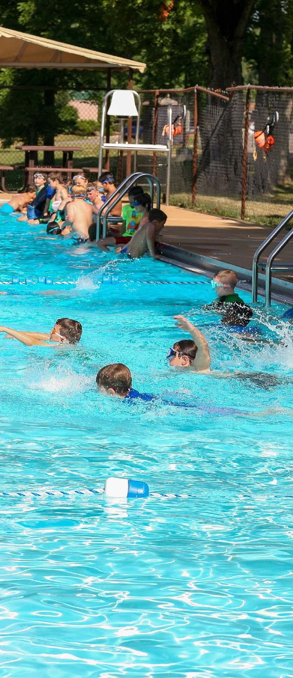
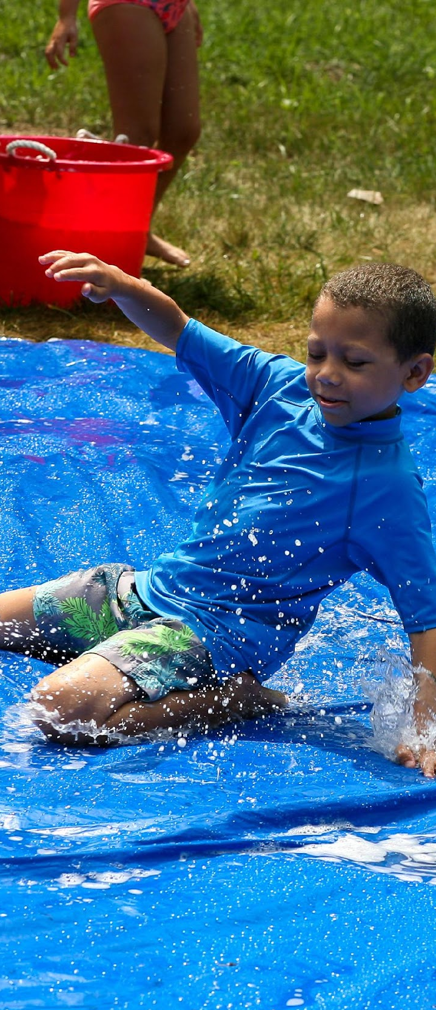
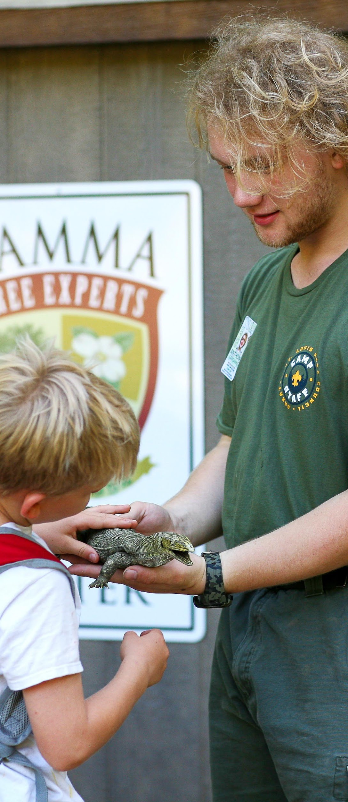
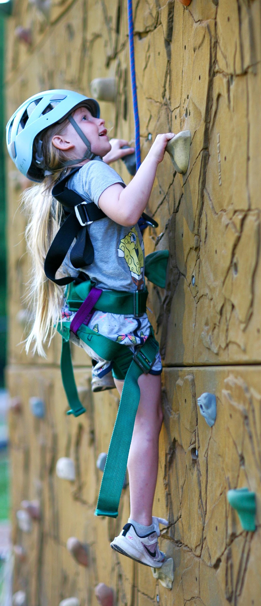
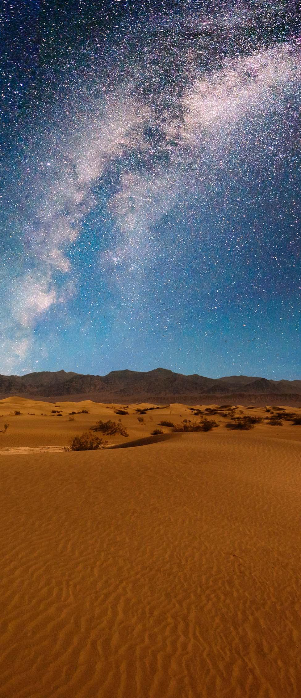

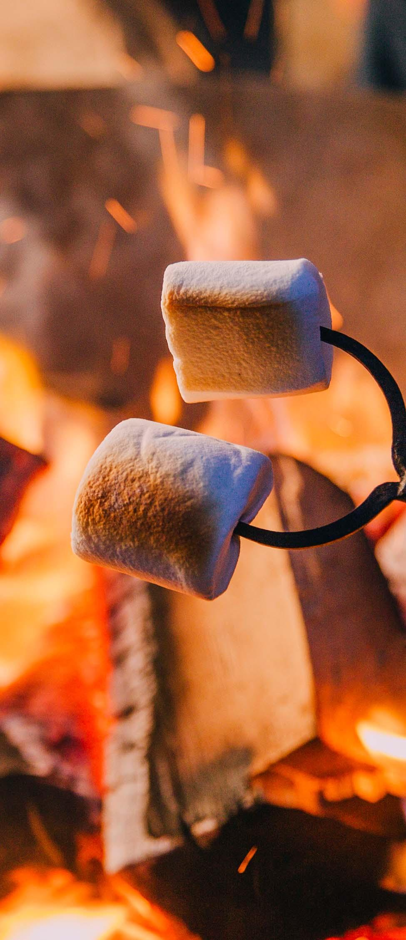
2025 Cub Scout Summer Camp
WEEK 1
North Carolina
WEEK 2
Utah
WEEK 3
Arizona
WEEK 4
California
Notes:
Welcome! My name is _______________________ and my favorite thing about summer camp is __________________________________________ - today we will be going over the Cub Scout summer camp options for this coming summer in 2025! We have a few changes to the programs from the past and we are excited to go over everything with you today.

Slide 2
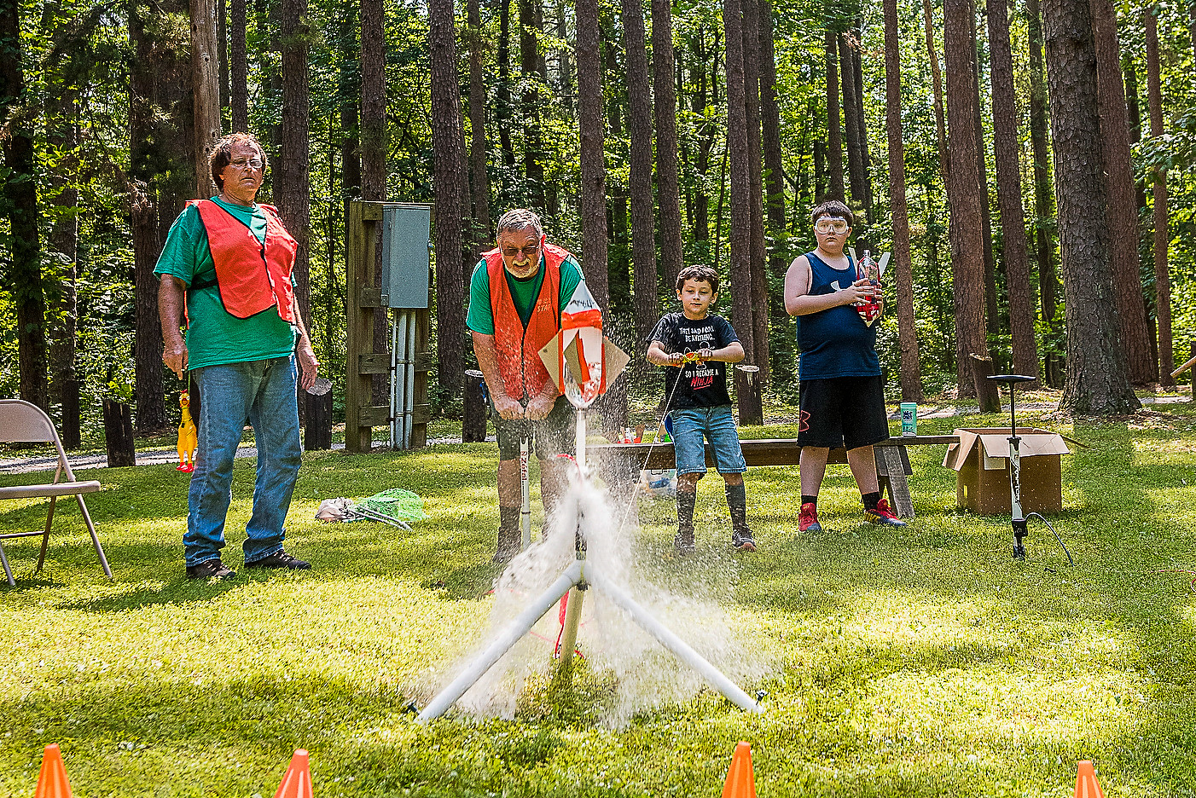
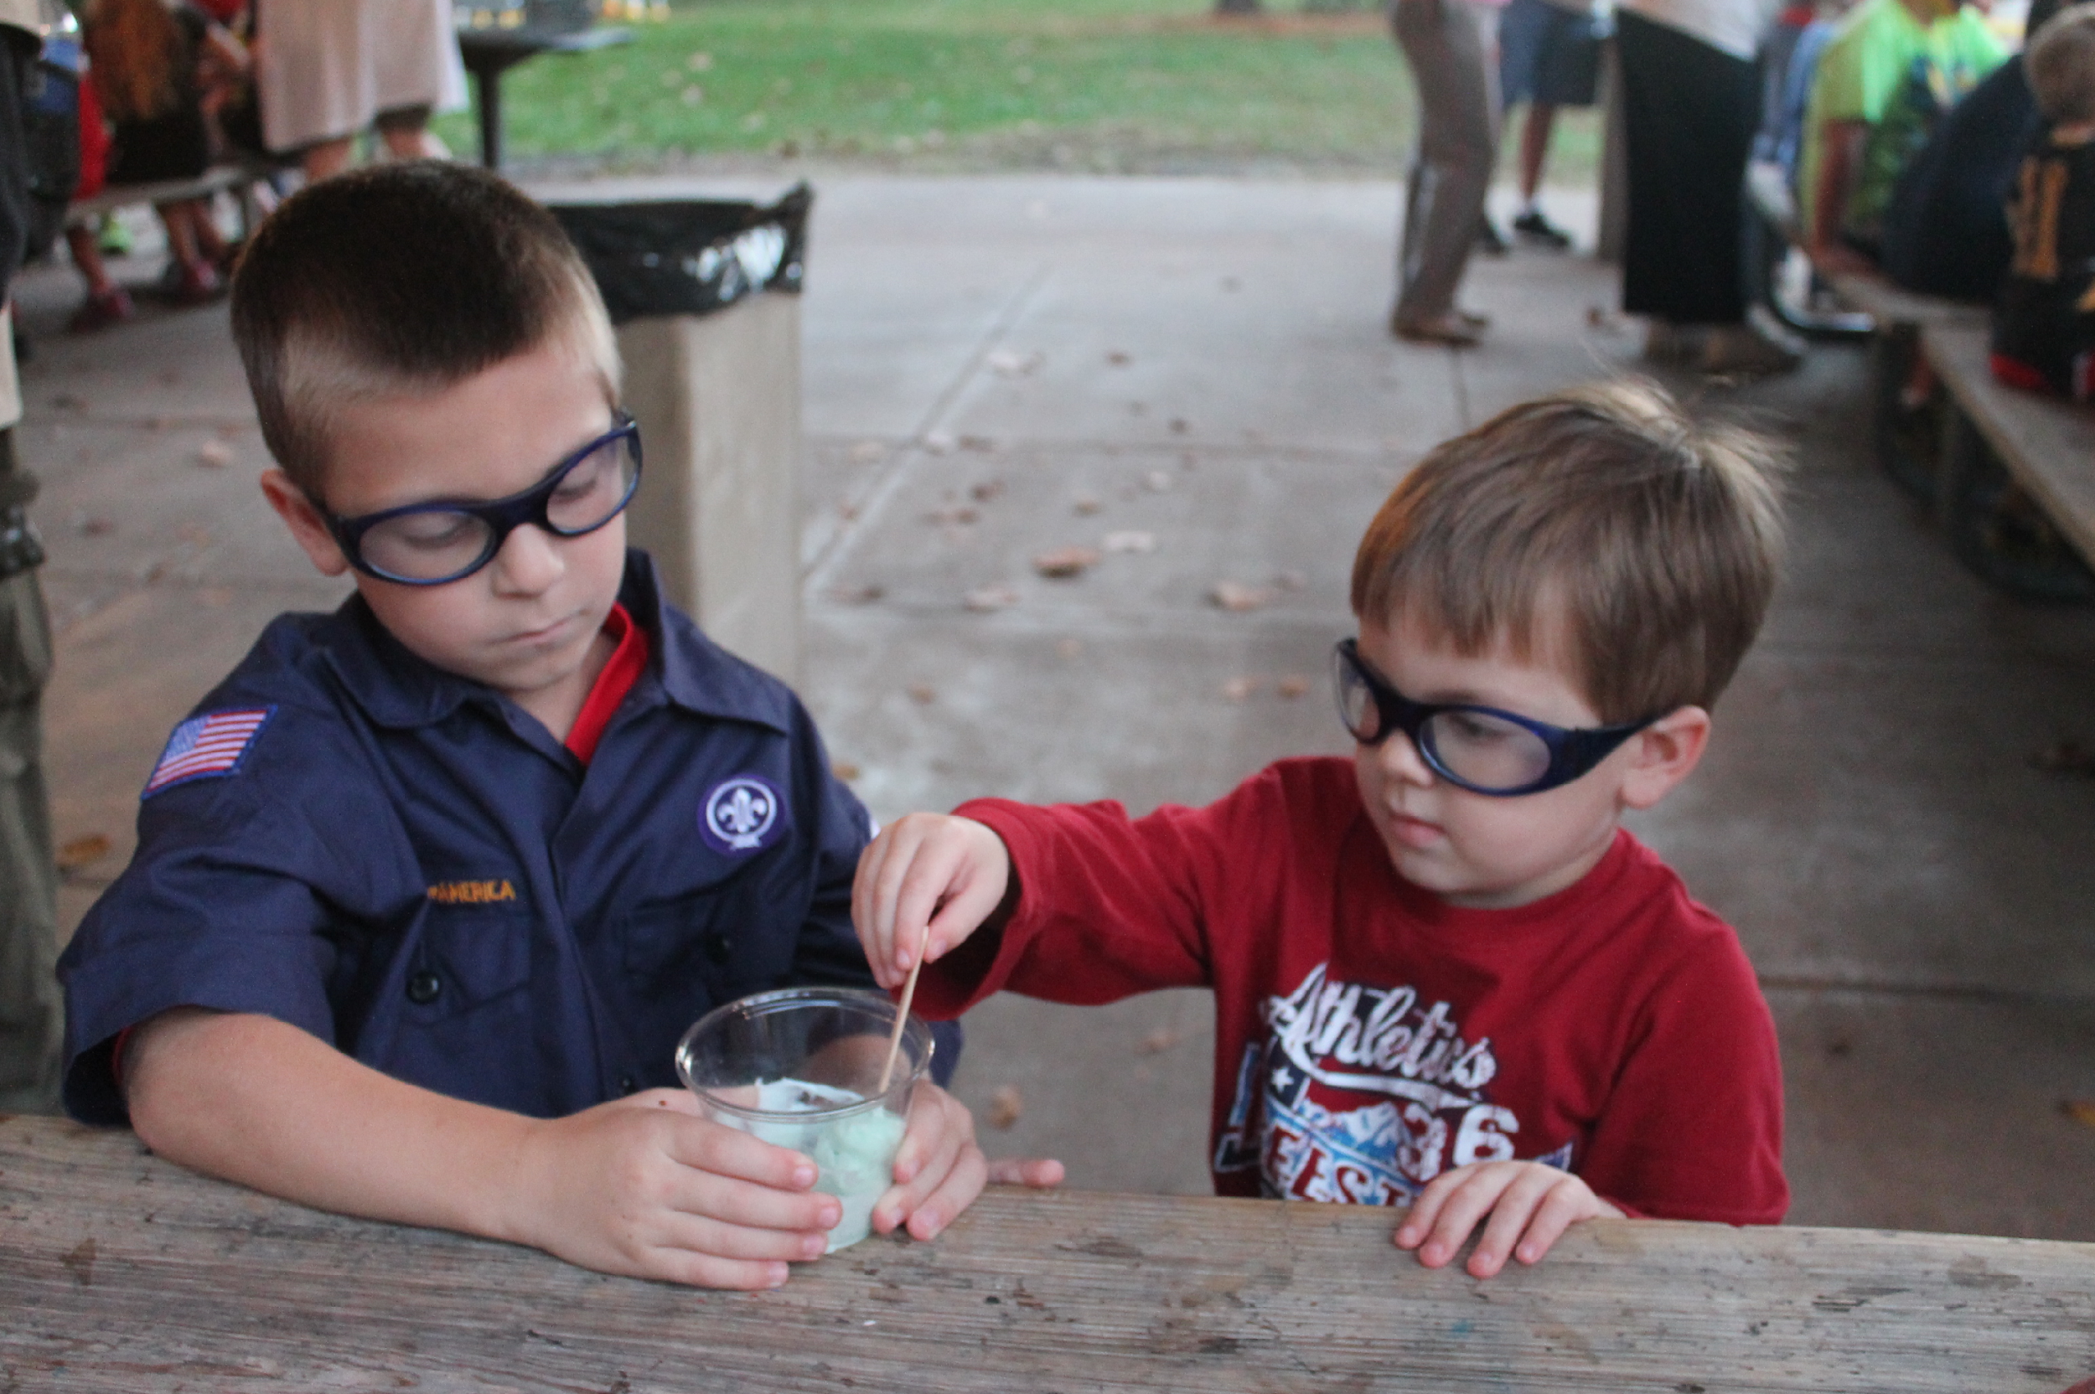
Why do kids attend summer camp?
Fun
Friendship
Lasting Memories
Why do parents want their kids to go?
Meaningful Experiences
Advance thru the Cub Scout program
Grow in skills a classroom cannot teach

Slide 3
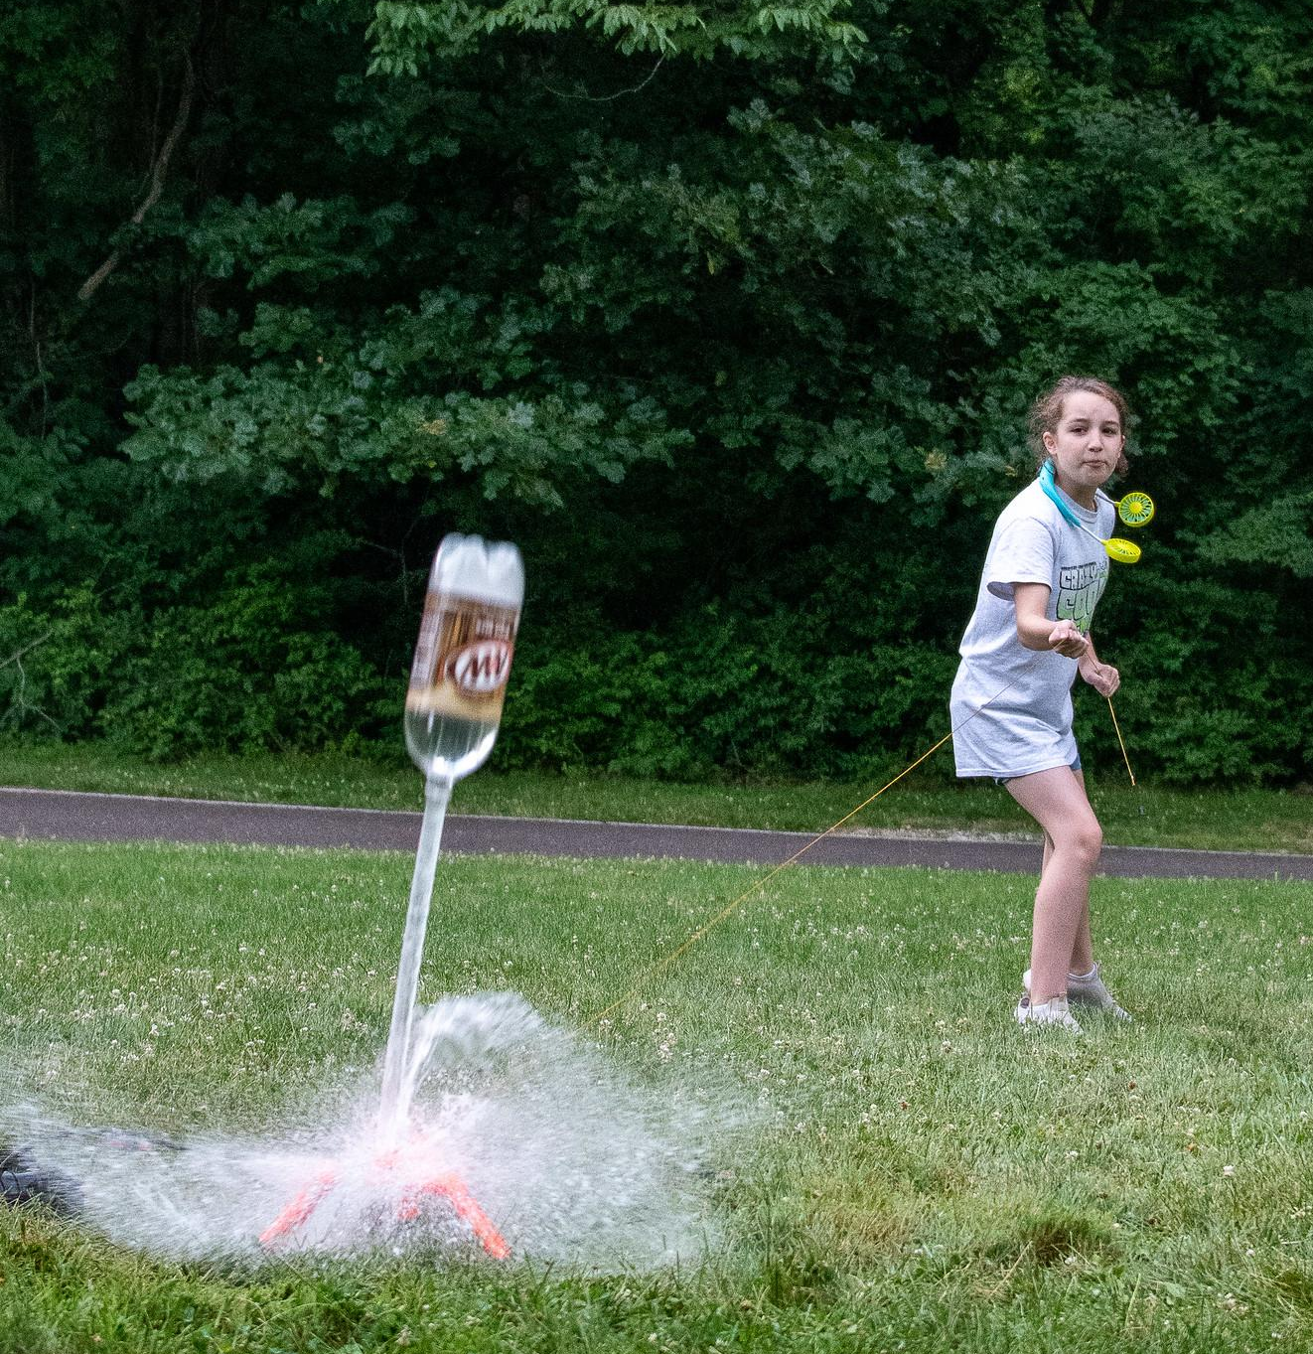
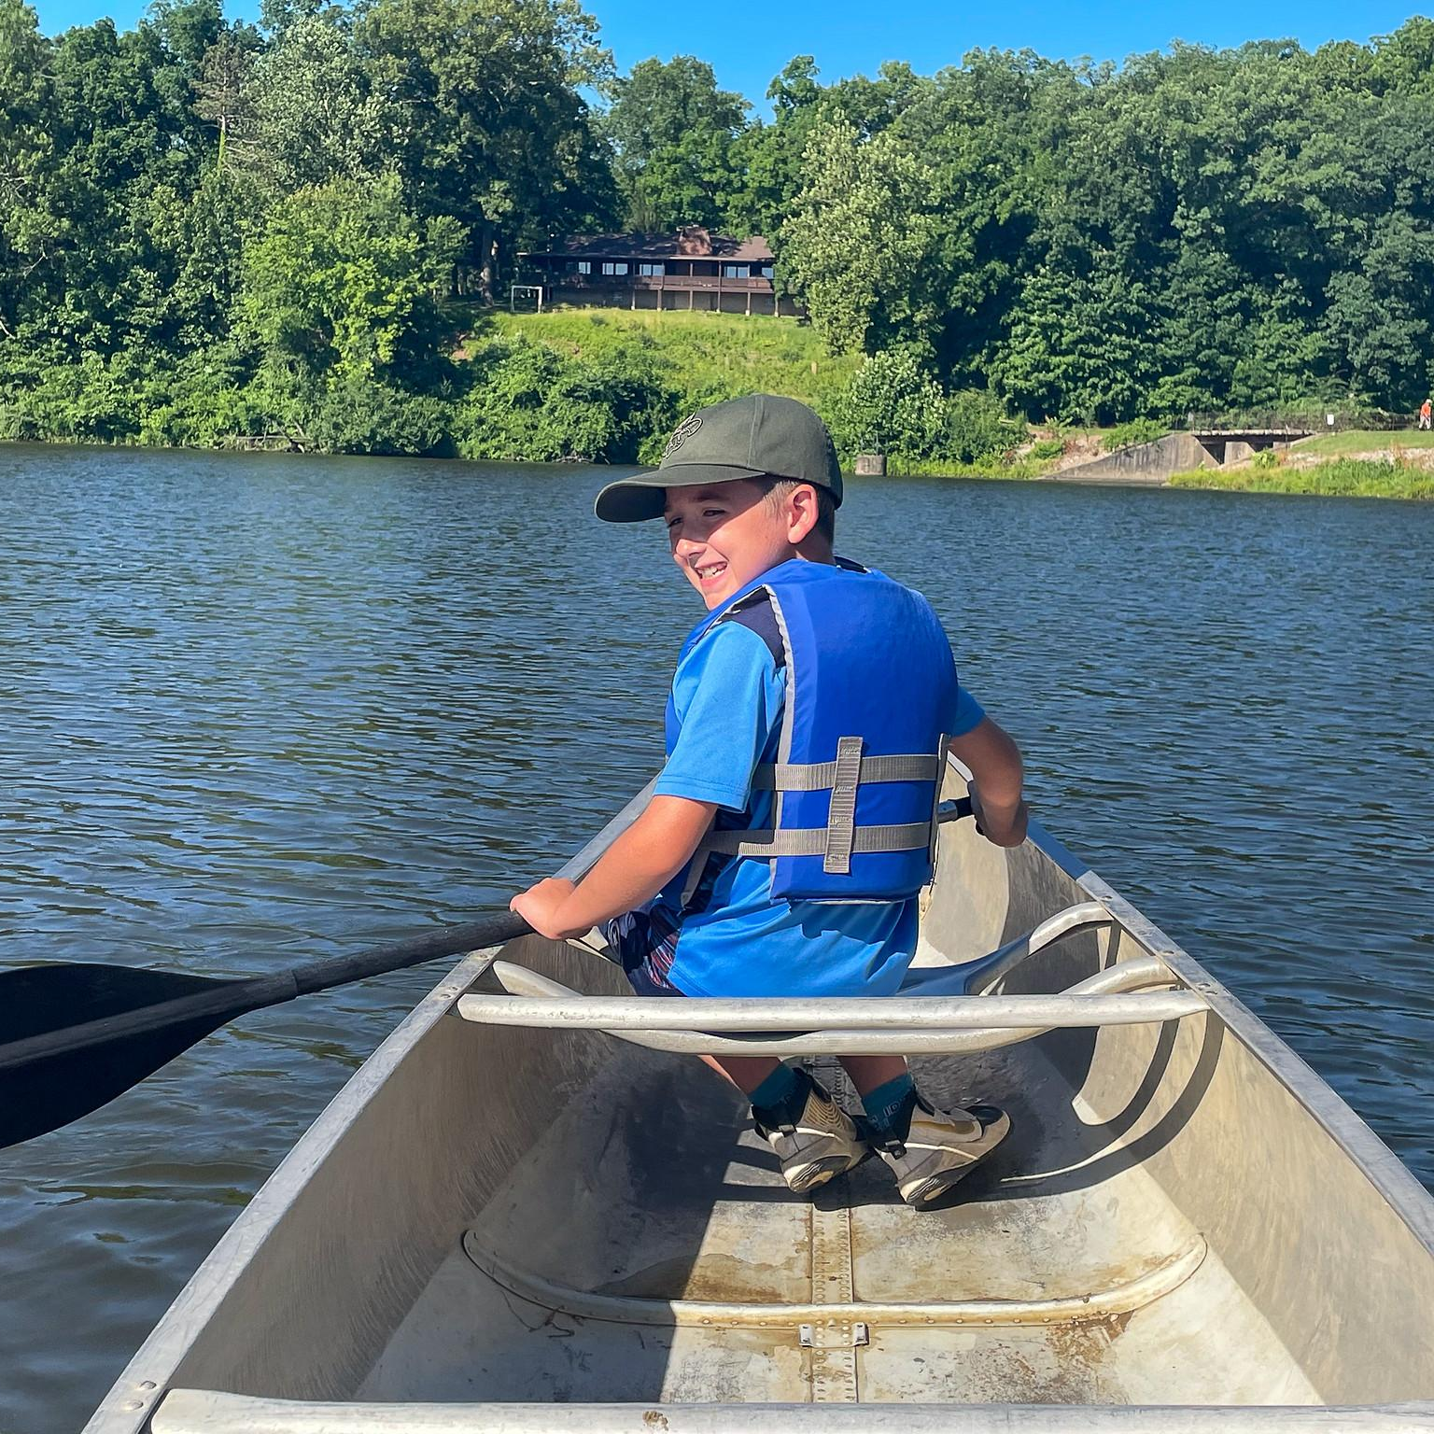
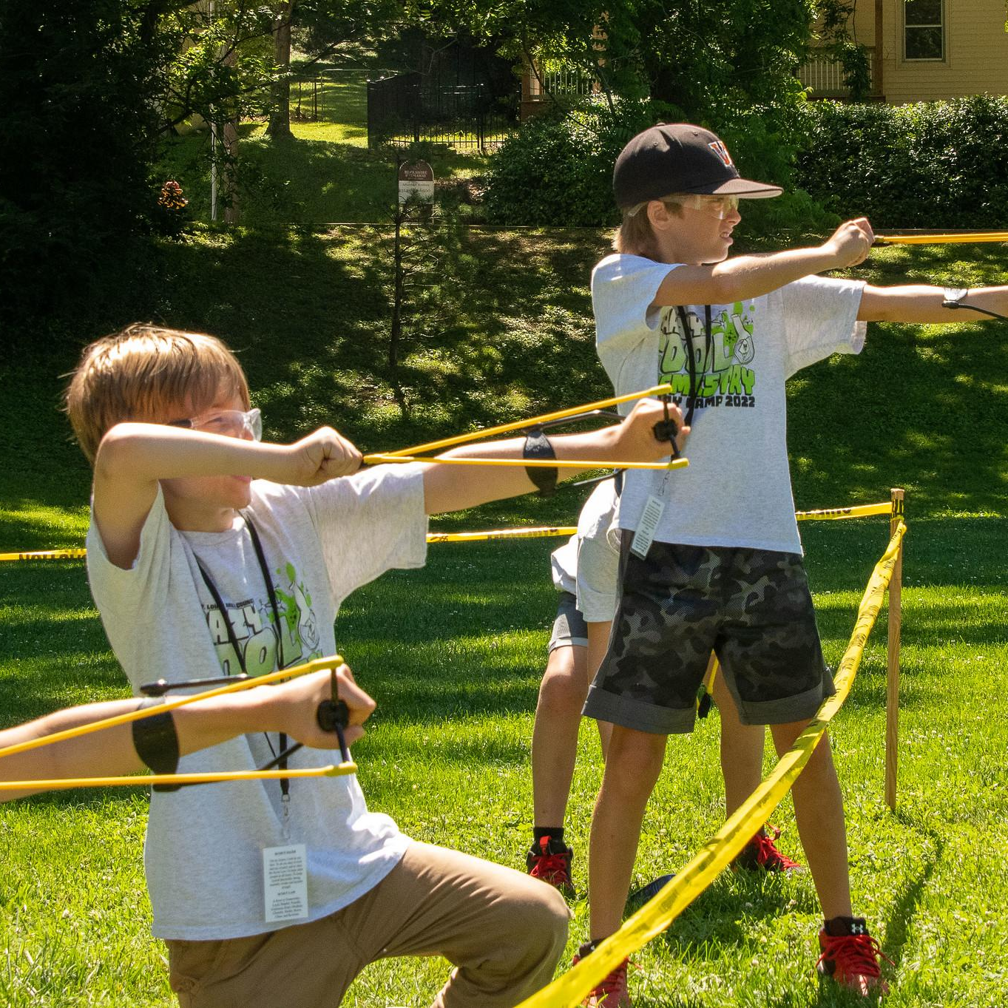
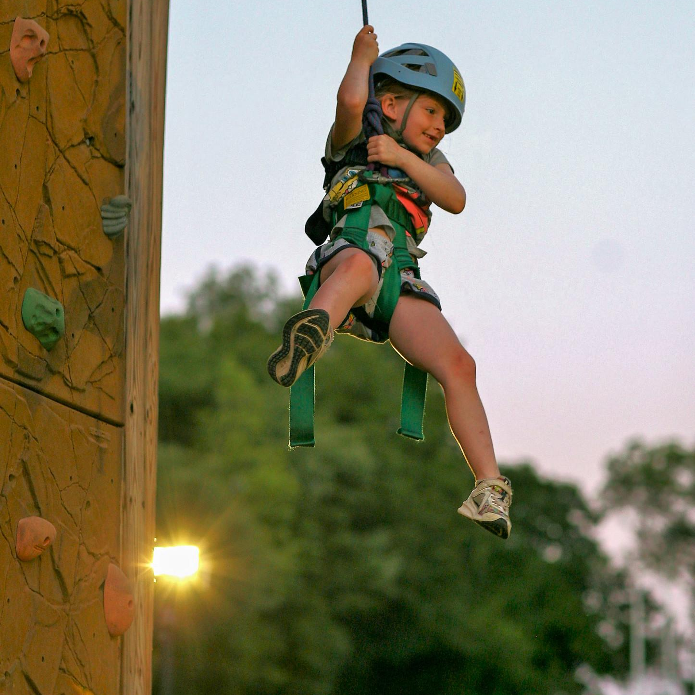
CUB SCOUT SUMMER EXPERIENCES
Overnight Camp
Day camp
In Your Neighborhood
3-5 days in length, during the day or in the evening – themed around “Where the Wild Scouts Are”
2 Overnight Options
2-4 night options – have fun and earn advancement – attend as a pack or as a family
Notes:
As a Cub Scout, there are two ways to camp during the summer: Day Camps and Overnight Camps! Day camps operate during the day or evening and are generally about a week in length. Our Overnight camps have two different types or options to choose from (or attend multiple!). There are 3 night and 4 nights options to attend as a pack or as a family. The pictures on the screen show some of the activities that happen at our Cub Scout summer camps!

Slide 4

The
Day Camp Experience
Spend time with scouts and leaders in your neighborhood
Outdoor skills
Shooting sports (BBs, archery, slingshots)
Science experiments
Crafts around the theme, “Walking on the Moon”
Games and team building
Watch your Scout learn new skills and make friends
Scouts receive a patch & t-shirt
Beaumont’s Grizzly Day Camp – Council’s drop off/pick up summer camp with weekly themes – swimming daily & mud cave
Notes:
This year’s day camp theme is, “Jurassic Jungle” and will focus on animals, outdoor skills, ecosystems, and nature exploration. During day camp, you will spend time with scouts and leaders in your area. There are many activities that go into day camp such as shooting sports, outdoor skills, science experiments/STEM, crafts, and games! Scouts will earn advancement, have fun and grow in skills throughout the week. There are over 30 day camps this summer, so use our interactive map on the website to find the one closest to you! All Scouts will receive a t-shirt and patch at day camp.
If you’re close by the Beaumont, check out our unique council run day camps called Grizzly Day camp. This camp allows you to not worry about adult leadership and feel free to drop off your scout each day! They will get to participate in the best of Beaumont, swimming every day and going in mud cave!

Slide 5
2 Overnight Camp Experiences
Cub Scout Overnight Camp
  (2-3 nights – ALL CUB AGES)
Webelos & Arrow of Light Overnight Camp
  (4 nights – Scouts entering 4th & 5th grades)
Notes:
These are the two different overnight camp experiences that you can explore as a Cub Scout. We will go over these options in the next few slides.

Slide 6
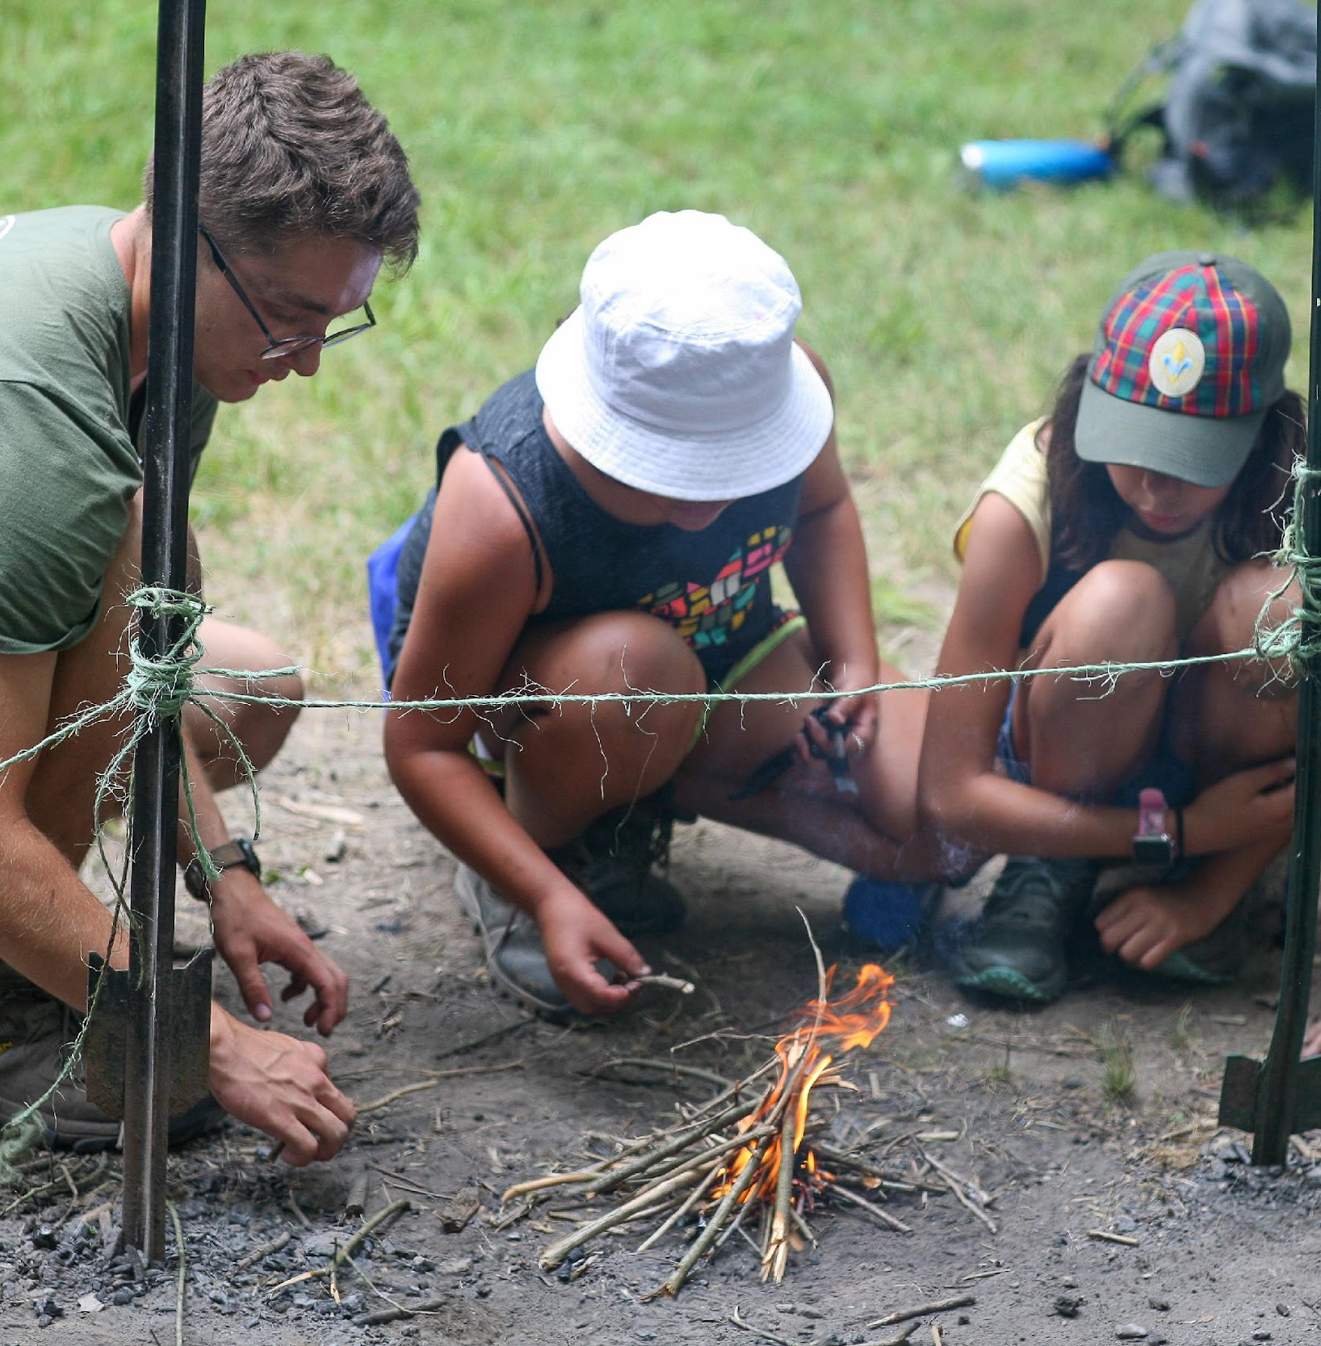
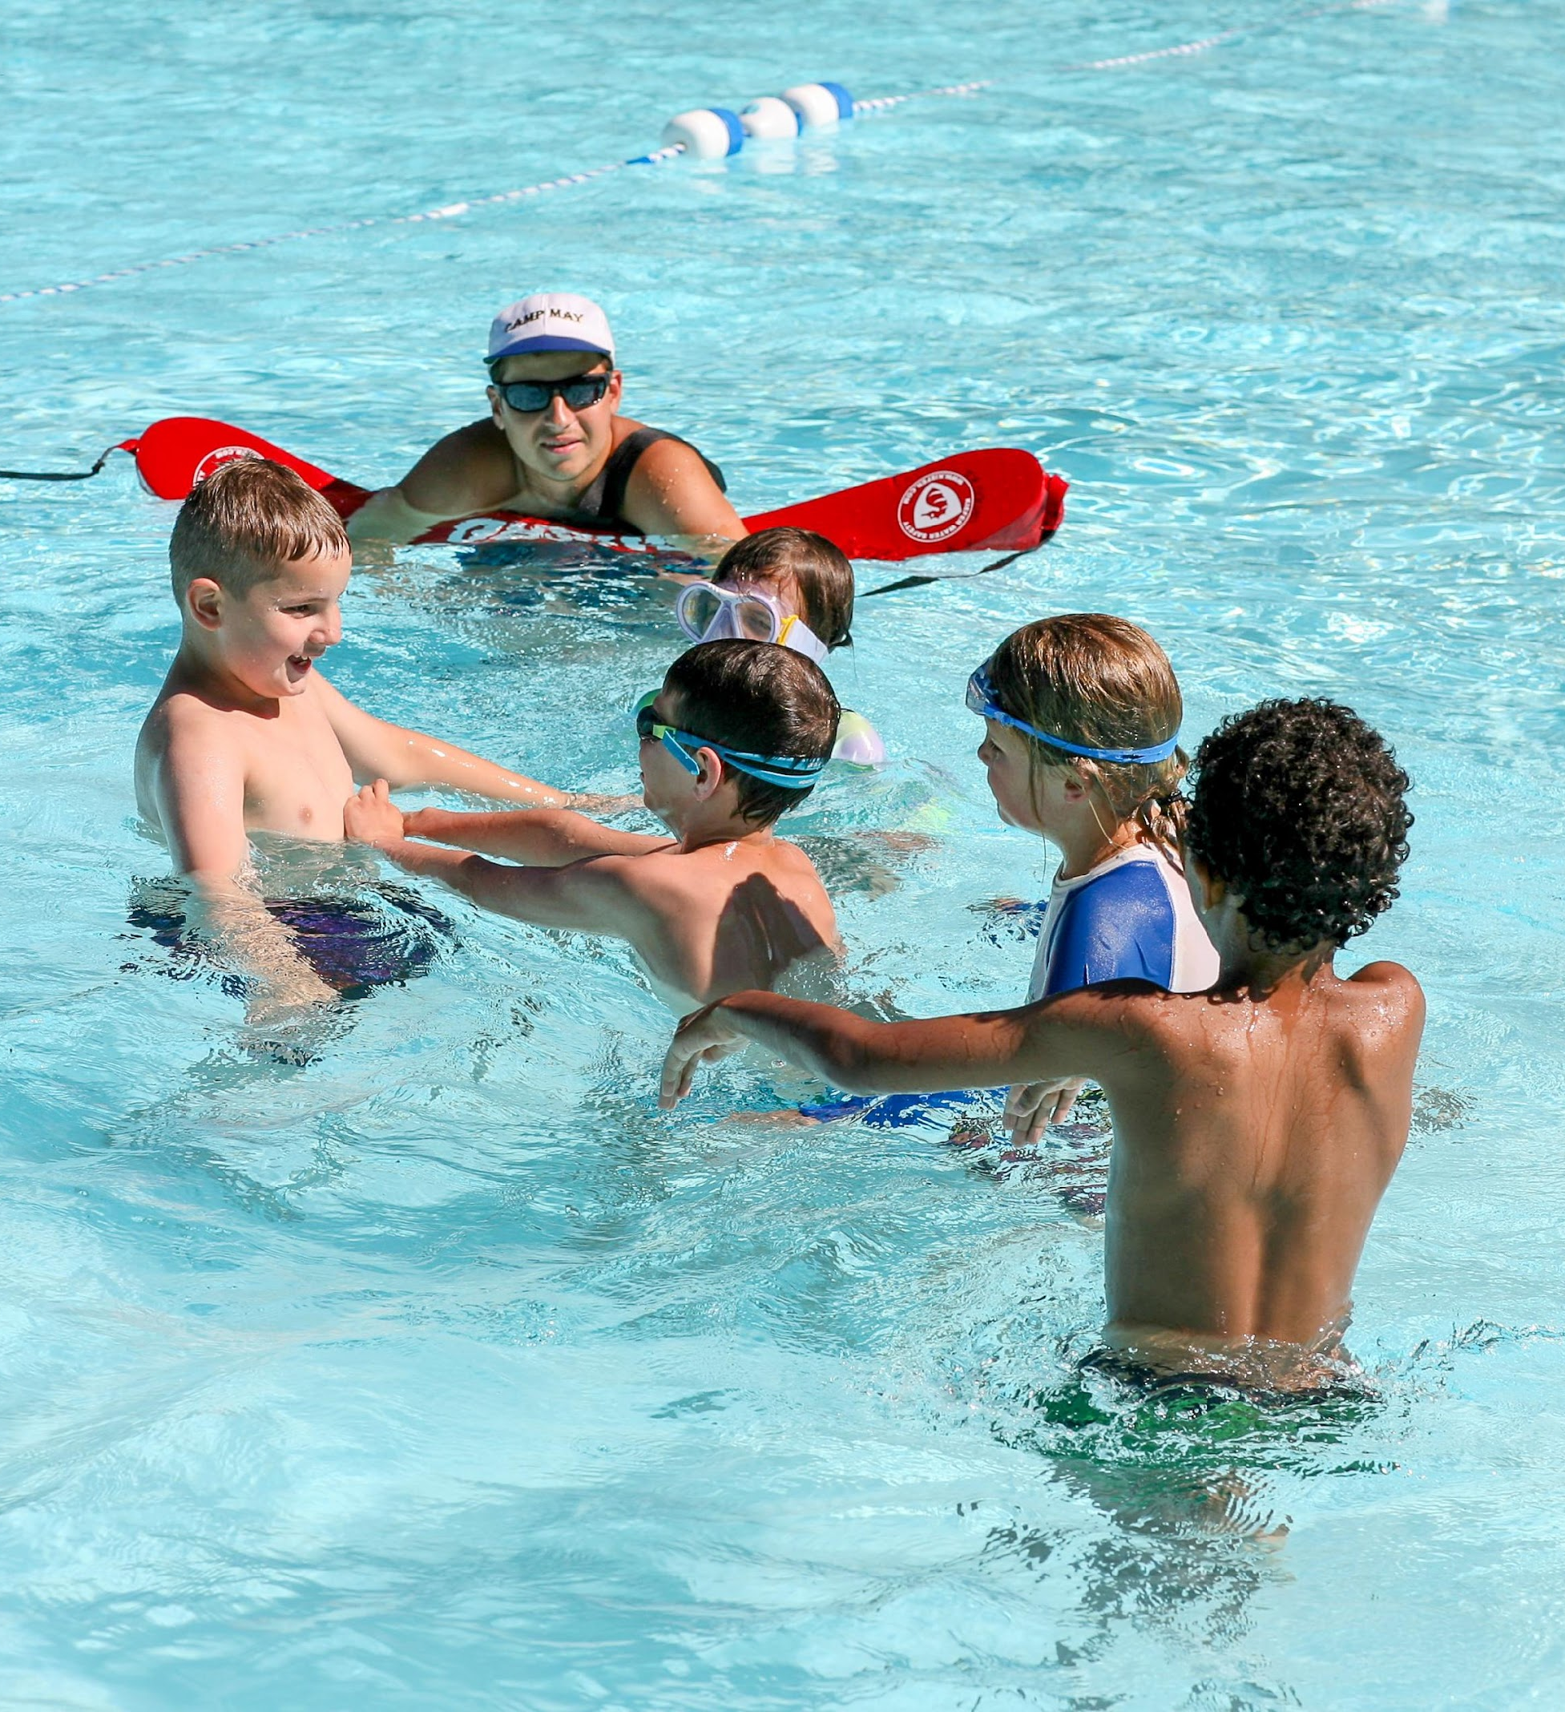
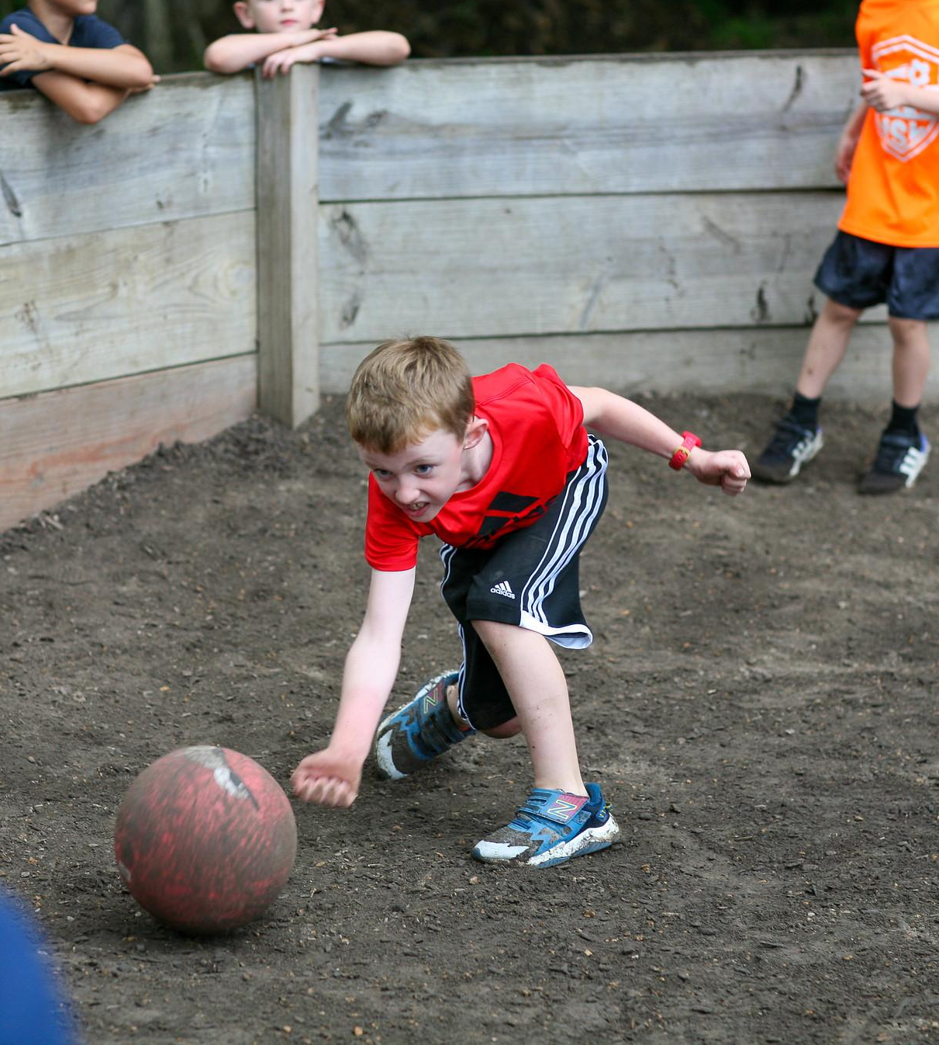
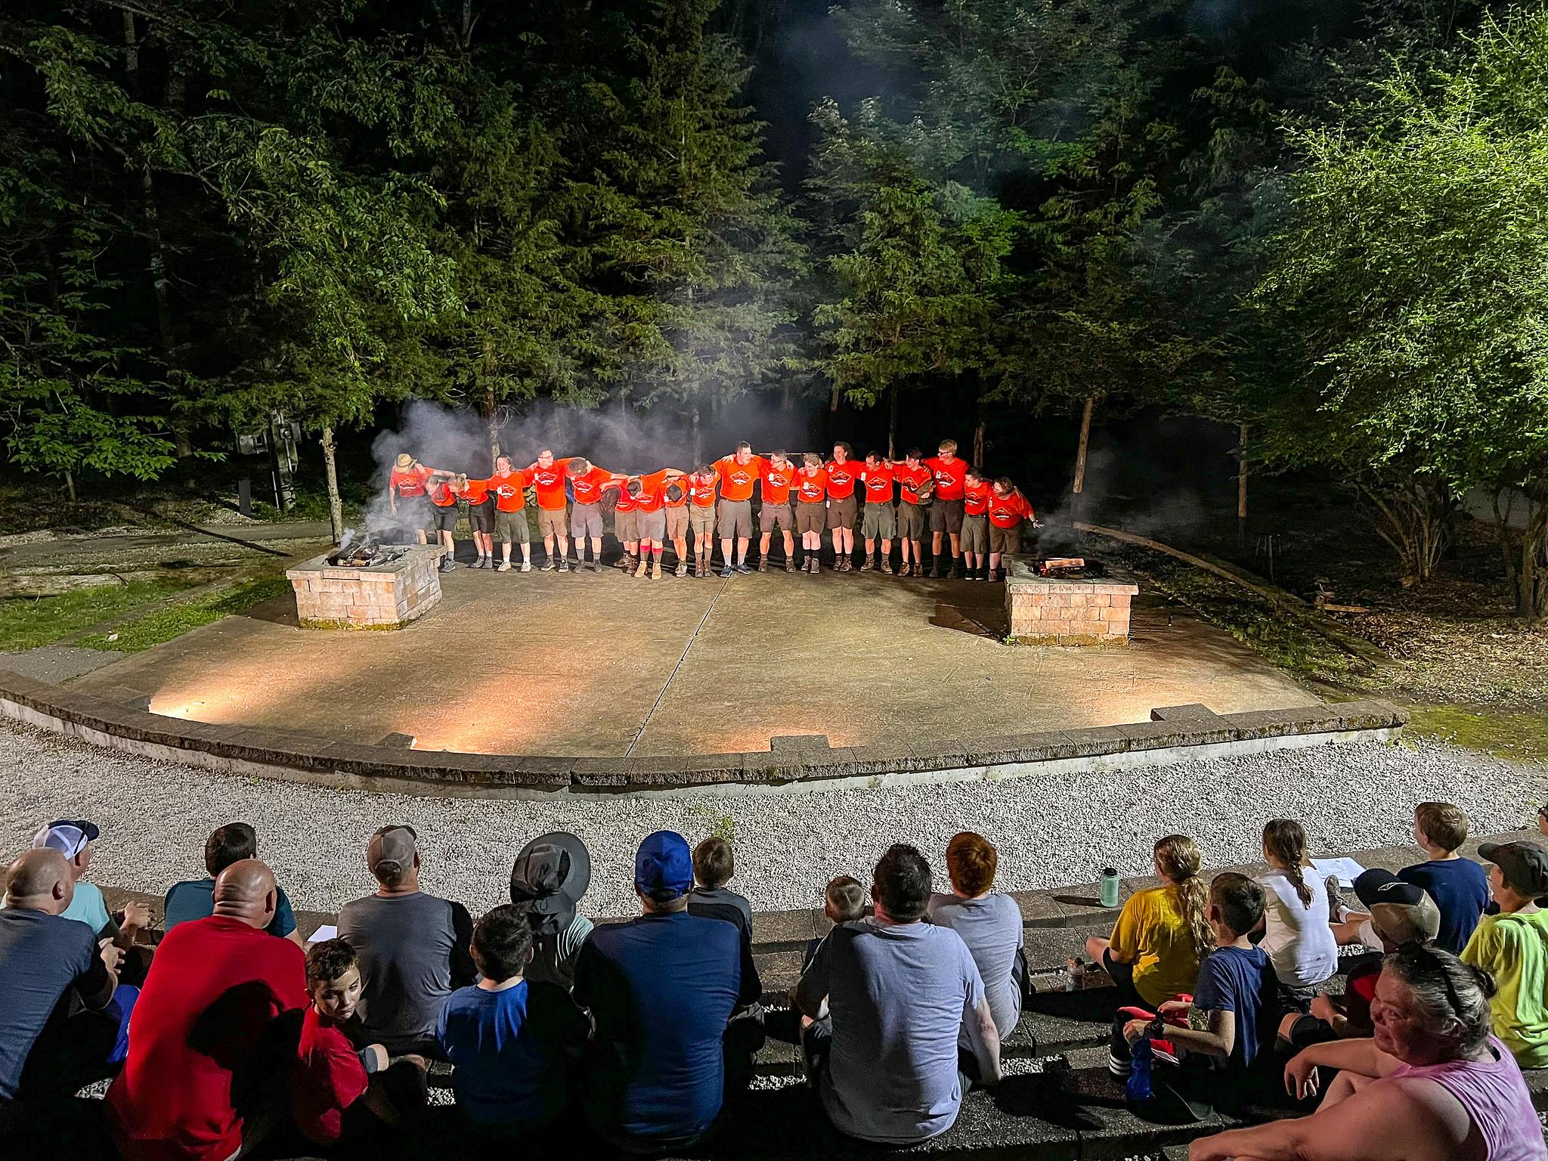
The Overnight Camp Experience
Activities at Overnight Camp
  Evening Campfire Show
  Swimming – both instructional and for fun
  Shooting Sports
  Outdoor Skills
  STEM
  Climbing
  Nature Exploration
Notes:
A camp staff of approximately 20-25 staffers put on the camp program at each overnight camp location. While a pack or family provides leadership for their campers, the camp staff brings the fun and expertise to our camp programs.
Here are the list of activities:
Swimming: both instructional swim and free swim. Parents can see their children learn this vital skill and come back from summer camp more advanced in their swimming.
Shooting Sports program: at each camp campers will get to try their hand at BB guns and archery by trained staff. They will develop better motor skills and coordination. They will get shooting experience, learn to respect shooting sports, and learn about safety.
Outdoor Skills: these programs highlight scout skills such as building a fire, wilderness survival, knot tying, and learning the ways of Scouting! They will have a general education of survival and camping from these programs.
STEM: can include activities such as observing through microscopes, creating chemical reactions, launching rockets, learning snap circuits, discovering the scientific method, and more!
Nature programs: observing wildlife local to the area (turtles, snakes, frogs, insects, etc.) and learning more about taking care of animals and our environment. Programs will discover local plants and give education on poison ivy and other plants to be cautious of. Planting and hiking the trails of each property are also part of this program.
Each overnight camp will have a campfire program during the first evening. The evening is filled with laughter as the campers will enjoy songs and skits put on by their very own camp staff!
All campers will receive a camp patch for attending! Meals and tents are provided as well.

Slide 7
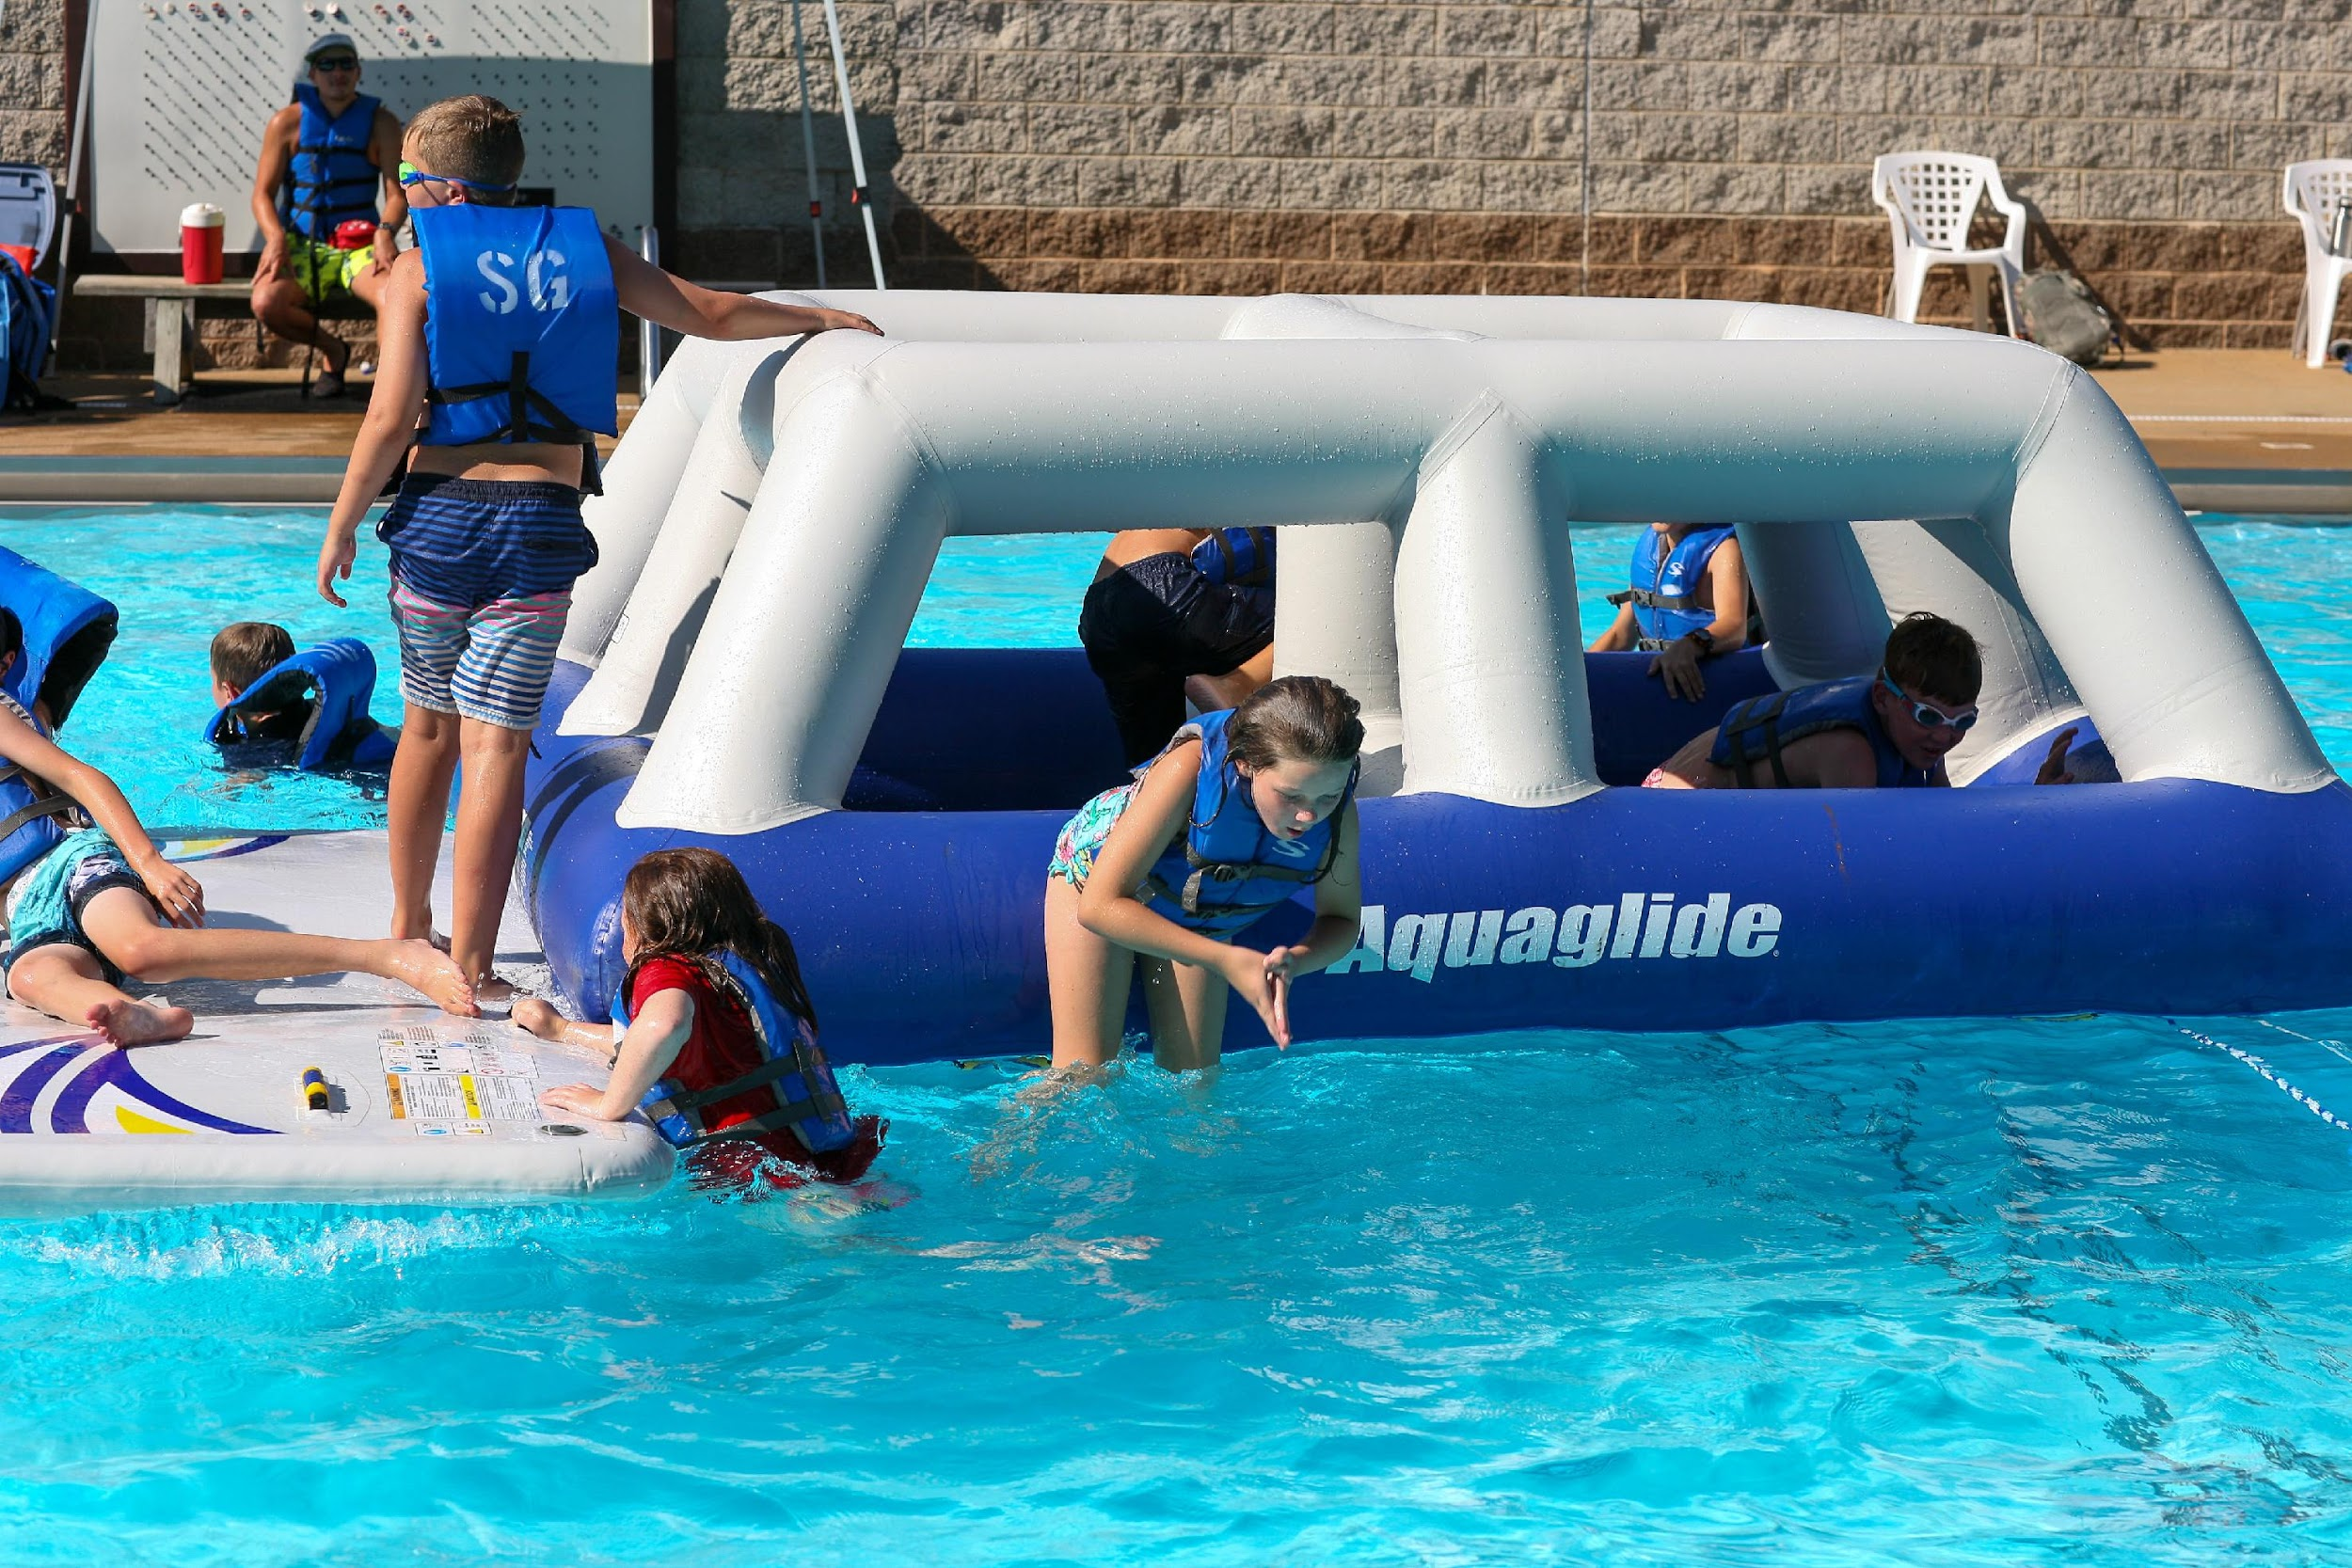
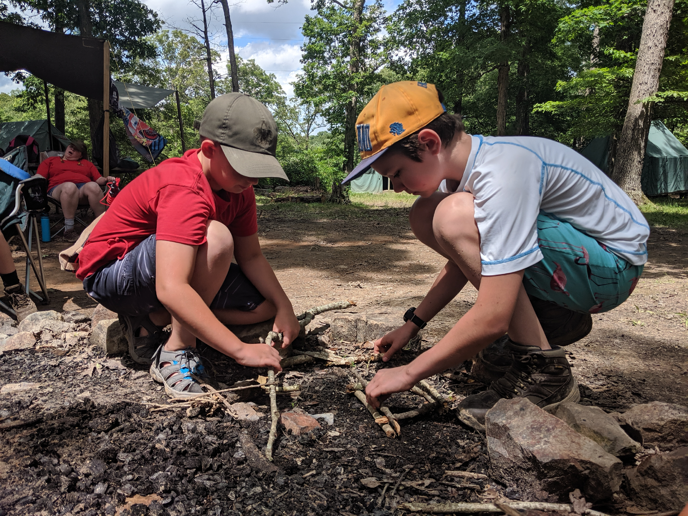
2 Overnight Camp Experiences
Cub Scout Overnight Camp
2-3 Nights/ 3-4 Days
For the entire pack! Come enjoy camp together and split into individual age groups for programs
Get scout advancements and have fun doing classic camp activities: Scout skills, shooting sports, swimming, nature exploration, stem and more
Webelos & Arrow of Light Overnight Camp
4 Nights/ 5 Days
For Scouts entering 4th and 5th grade
DESIGN YOUR OWN PROGRAM
  You choose the webelos/AOL electives! Get exactly what you want out of camp.
  In the afternoon, all webelos & AOLs will participate in classic camp activities such as swimming, shooting sports and more!
Notes:
Now we will go over our overnight camp options.
Cub Scout Overnight Camp is 3 nights and 4 days, you can attend as a pack or as a family. You will camp together with your group or family then split into age groups for the programs. Get scout advancements and have fun doing classic camp activities: Scout skills, shooting sports, swimming, nature exploration, stem and more.
Webelos & Arrow of Light Overnight camp is 4 nights and 5 days long – perfect for preparing your Webelos & AOLs for Scouts BSA Camps! You will choose and design your own webelos/AOL program. Each morning you will go to your pre-selected webelos/AOL elective activities and learn exactly what you want to learn as a webelos/AOLs. In the afternoon, all scouts will enjoy classic summer camp activities such as swimming, shooting sports, scout skills, nature or stem. Go to our website to see a sample schedule and see the list of webelos & AOL electives you get to choose from. There are 6 total webelos & AOL electives to choose from and your scout will select 4 of them to complete at summer camp. This way you customize your webelos and arrow of light camp experience.

Slide 8
Discounts & Financial Assistance
Save $ by registering by April 15th
- Save $20 off overnight camps & $10 off day camp
Financial Assistance – Camperships
- Can cover up to 50% of camp fee
- Online form linked to registration
- Applications due by May 1st
Notes:
There are two ways to save money on Cub Scout Camping this summer. The primary one is to register by April 15th to save $20 off each overnight camp registration & $10 off each day camp registration. Mark your calendars NOW for April 15th and be sure to register by then! Secondly, there is financial assistance through “Camperships” A Campership is just our word for a scholarship to attend summer camp for those who need financial assistance. You will apply for this through the camp registration form. It can cover up to 50% of the camp fee. Applications are due by May 1st and can be applied towards Cub Scout Overnight camps or day and twilight camps.

Slide 9

Notes:
The best way to organize your group to attending summer camp together is to pick a date/session EARLY! Have families add it to their calendars before their summers book up, and then work out which adults can attend which days. Adults are welcome to change in and out through a cub scout session. Just as long as there is coverage! Once you have the dates and adults on board, register before April 15th to get your discount. Once you do register for camp, there is a camp manual for each camp complete with packing lists and YouTube videos on tips for packing for camp. Let us help take the stress out of your trip, utilize these resources!

Slide 10
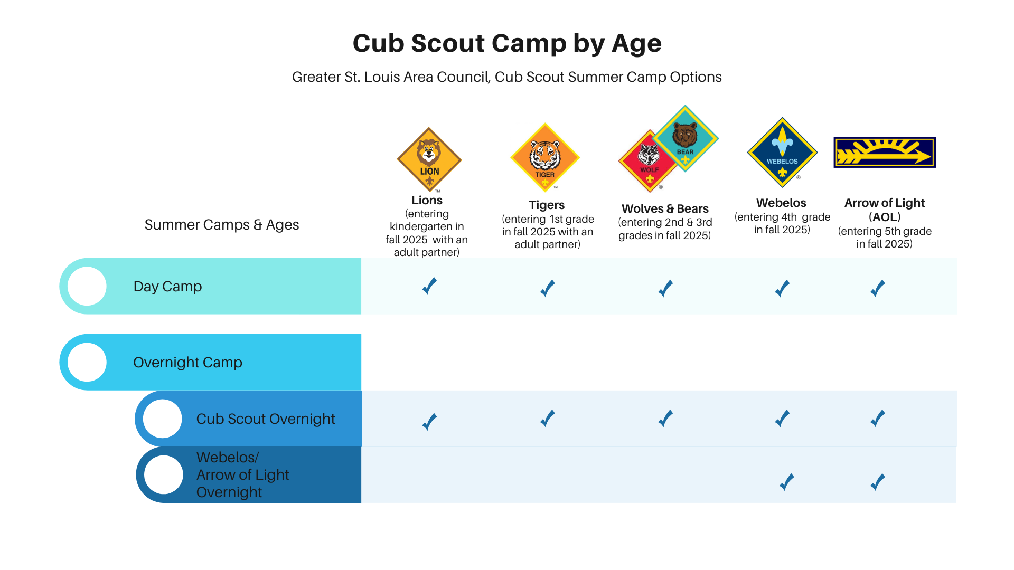
Notes:
This concludes our presentation on the Cub Scout Summer Camp options. Please review the chart here that lists our options and what is best for each age group! Any questions we can answer?

