Slide 1
Family Friends of Scouting

Slide 2
“Introduction …………….

Slide 3
What to expect in Today’s Presentation
Share a Comprehensive and inspiring Friends of Scouting Video
Tell you what the Friends of Scouting campaign is and what it dose
I’m going to ask you to join me in donating to help the mission of Scouting
I’m going to make it easy to donate at the end of the presentation
I’m Going to thank you for being part of the life changing programs of the BSA

Slide 4
2021 Friends of Scouting Video

Slide 5
What is Family Friends of Scouting?
Family Friends of Scouting is our district’s fundraising campaign
Sometimes called FOS
Completely supported by Scouting families
Is the direct source of funding for each district
Plays a large part in the trajectory of the following year

Slide 6
Where does Friends of Scouting money go to in Madison and Bond county?

Slide 7
What makes up the “Direct Unit Support” section?
Improvements to Camp Warren-Levis
Over $310,000 worth in the past 5 years
22 camperships in 2019
STEM scholarships to Cahokia Mounds youth
Last year our district supported nearly 400 scouts with some type of financial assistance
34 eagle kits
40 uniforms to youth and adults
5 outreach programs
After-school programs and in-school Special Needs Scouting in classrooms

Slide 8
BSA National Chapter 11 Bankruptcy
Dose not affect local Friends of Scouting donation
100% of Friends of Scouting donation support local Scouts
90% of Abuse Cases happened 40 years ago that Created the need for the National office file Chapter 11
These cases happen before we implemented our Youth Protection policies

Slide 9
What makes up the “Direct Unit Support” section?
Provides recruitment flyers incentives & promotions materials.
Youth & adult leadership training opportunitie
Financial scholarships for summer camp, STEM programs, Merit Badge skill centers & other year-round programs
Youth Protection trainings and other safety programs

Slide 10
It’s time to join me in supporting Scouting. Consider investing in one scout at the $216 giving level.

Slide 11
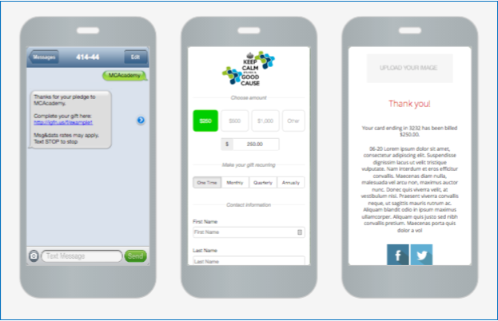
Text: METROE21 to 91999

Slide 12
Use fillable pledge card attached in the chat & email it to Cheyenne.Vandegrift@scouting.org
Payment can be a one-time gift
Paid quarterly
Paid monthly

Slide 13
Be a Gateway Giver! A Gateway Giver is a Friends of Scouting supporter who chooses to make their contribution over recurring monthly payments

Slide 14
Unit Goal is $.............
Reach our unit goal & receive free cloth rank advancement patches from the date you achieve your goal unit 3/31/2022
Or Receive a $75 voucher to use towards any facility rental at a GSLA Camp

Slide 16
Thank you for giving me a chance to share this presentation with you.
Here is my Contact information:
…………………………………..

Slide 17
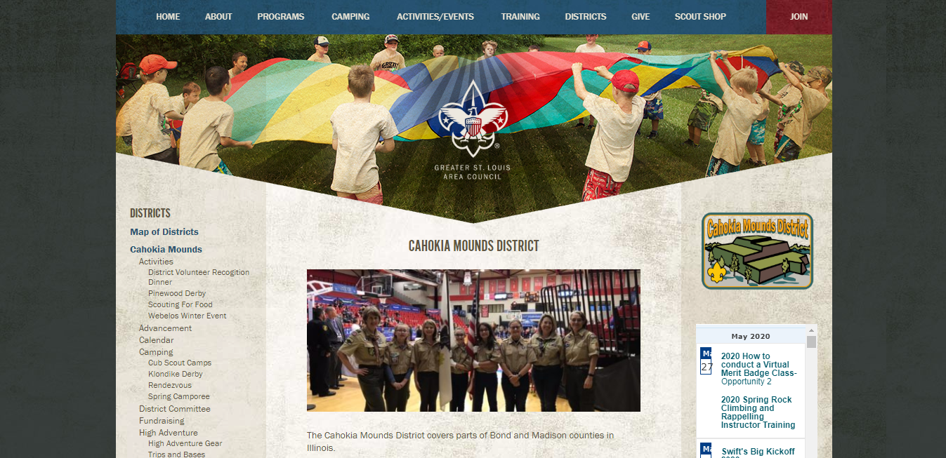
Growing Our Reach

