Slide 2
Introduction
Hello, my name is _____________ & I’m a volunteer with the Greater St. Louis Area Council Friends of Scouting Campaign.
I have been invited by your unit leadership to motivate & inspire you to join me in supporting the life changing programs of the Boy Scouts of America by donating to the annual friends of scouting campaign.

Slide 3
Current Situation
We just finished a year like no other, and this year’s Friends of Scouting Campaign is even more critical than in years past. The pandemic has crippled many of our revenue sources.
Despite this, we are working hard to teach our scouts to come together to learn, grow, and serve even when the word is upside down.
The Scouting program is one of perseverance and determination, but we need your help to meet the needs of our local scouting programs.

Slide 4
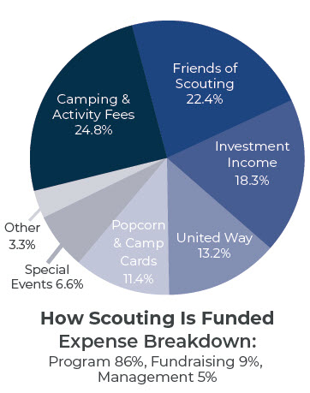
What is Friends of Scouting (FOS)?
District & council annual fund-raising campaign in which we ask our scouting families to invest in the future of Scouting.
It makes up 22% of council budget and the council invest $216 into each youth yearly

Slide 5
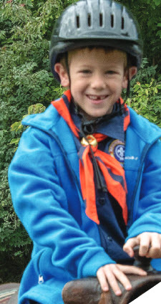
What Happens to your Donation?
Your gift stays here in the community.
Provides recruitment flyers, incentives, promotional material, youth & adult trainings, subsidized district and council camping activities, and upkeep at our camp properties.
Financial scholarships for summer camp, STEM Programs, merit badge skill centers & other year-round programs.
Provides the 700 Eagle Scout awards given out each year

Slide 6
Why I devote my time to FOS?
My Story
Support from the district or council has made a major impact on this family.

Slide 7
Friends of Scouting 2021 Video
https://www.youtube.com/watch?v=z4takO90GvI

Slide 8
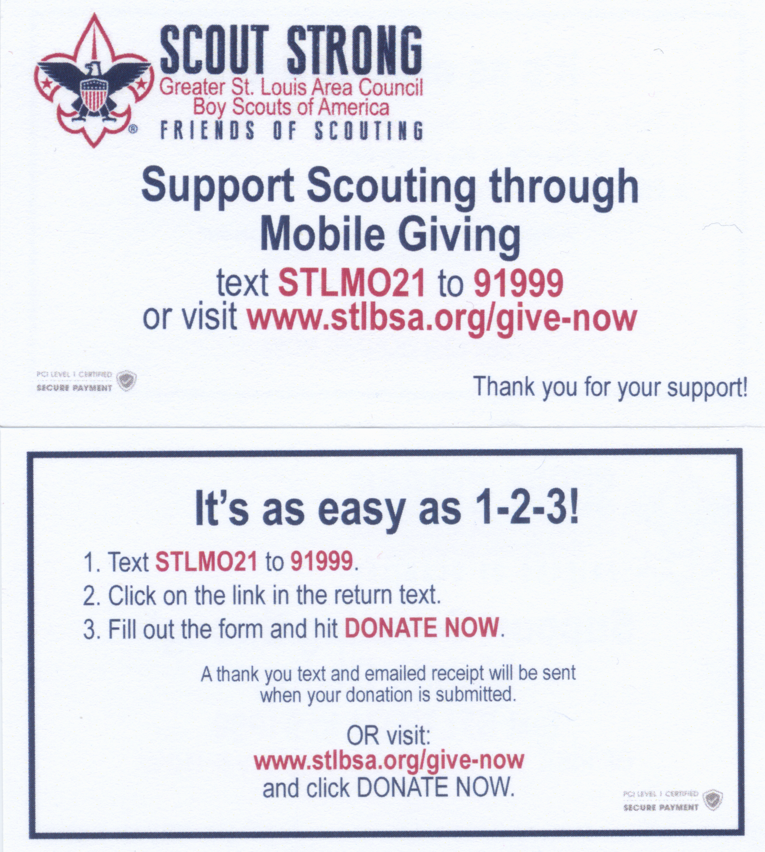
How to Donate or Pledge
When donating remember we are in the New Horizons District and be sure to give your unit #
Consider investing in one scout at the $216 level
Mobile Giving from your smartphone
Text STLMO21 to 91999
Or donate online
www/stlbsa.org/give-now

Slide 9
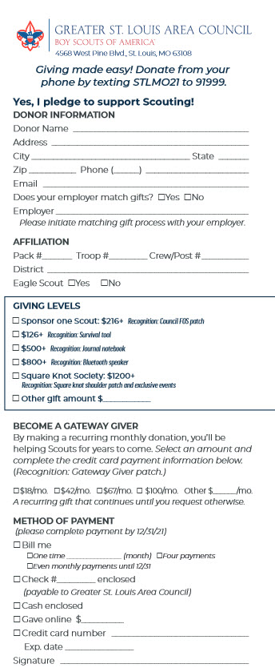
How to Donate or Pledge
Fill out Pledge cards and pay with cash, check or credit card or pledge to pay at a later date
Gateway givers monthly support option (special drawing for a free week at camp!)
Check with your employers to increase the power of your gift through company matching.
https://stlbsa.org/wp-content/uploads/2020/08/2021-Family-FOS-Brochure_STL-MO.pdf

Slide 10
Incentives – Thank You!

Slide 11
Unit Goal & Recognition (Ribbon)
Each unit has a fundraising goal.
Units which reach the goal will get Free Rank Advancement patches till 3/31/22 or $75 voucher to use towards any 2021 facility rental at a GSLAC camp (excluding summer camp)
Ribbon for Unit Flag
Individual and unit incentives will be delivered to unit leaders.

Slide 12
THANK YOU!
Thank you for inviting me to speak with you today.
Does anyone have any questions?
I will be on the virtual presentation for a little longer and will put some links in the chat.

Slide 14
Reminders – Slide for Presenter
Presentation should be no more than 10 minutes
Introduce yourself (Update Slide 2)
Stress the importance of the campaign
Share your personal experiences (Update Slide 6)
Make sure to go over how to give (Mobile Giving, Online Donations, Mail Pledge Card).
Discuss Matching Gifts
Go over Unit Goal and indicate all incentives will be delivered to unit leader
Say Thank You!

Slide 15
TIPS – Slide for Presenter
Be Prepared
Double check all info (Date/Time/Zoom Info)
Speak with Leader beforehand. Encourage leader to give the first gift during presentation
Consider downloading the FOS video onto your computer for better streaming (make sure sound sharing is clicked in zoom).
https://www.dropbox.com/s/nt9uk2jlqjnhi2d/BSA%20Friends%20of%20Scouting%202021%20v10.mp4

Slide 16
Downloads – Slide for Presenter
Pledge Card:
https://stlbsa.org/wp-content/uploads/2020/08/2021-Family-FOS-Brochure_STL-MO.pdf
Individual Incentives
https://stlbsa.org/wp-content/uploads/2020/08/2021-FOS-incentives.pdf
Mobile Giving Info
https://stlbsa.org/wp-content/uploads/2020/08/2021-FFOS-Mobile-Giving-information.pdf

